Slide 1

Numerical Simulations and Design of Fluidic Thrust Vectoring (FTV)
CFD Project / AAD 2023
Notes:
Everyone 3
Till 0-4, 21-28, 39-40
Tulip 5-10, 29-33
Yubo 11-16, 37-38
Tom 17-20, 34-36

Slide 2
Table of contents
01
02
03
Team Nozzle
Introduction to Fluidic Thrust Vectoring
Experimental Investigation by Waithe and Deere
04
05
06
Catia, Star CCM+ Configuration
Comparison of CFD to Experimental Database
Q&A
1

Slide 3
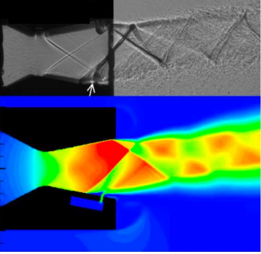
01
Team Nozzle
Introduction and Internal Organization
2

Slide 4
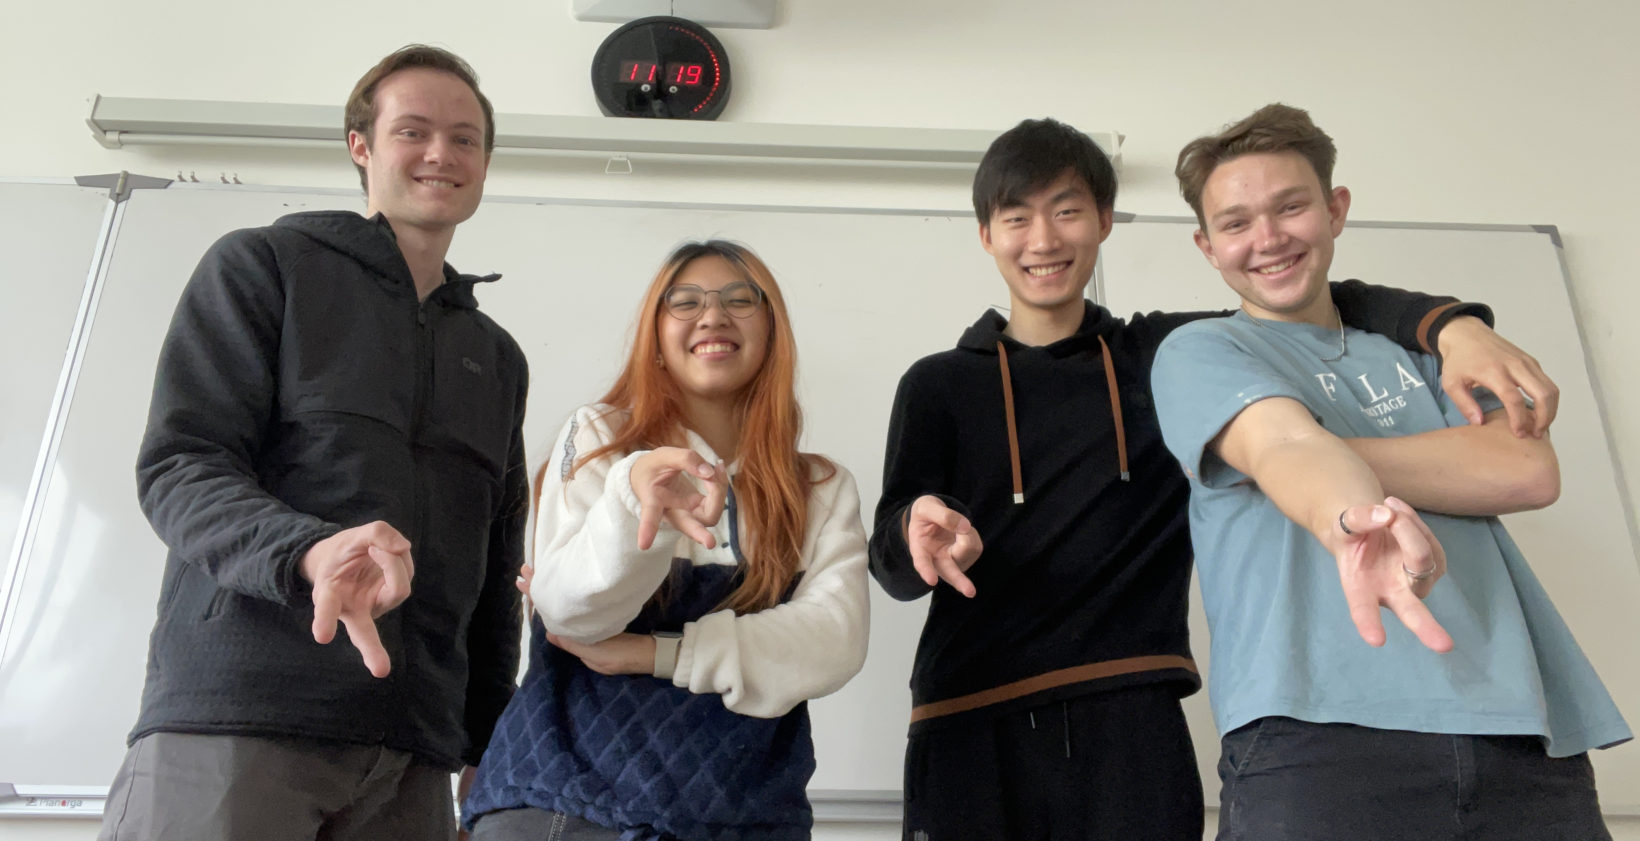
Team Introduction
Chief of Data Analysis
Chief of Documentation
Chief of Design and Simulation
Project Leader + Quality Manager
3
Notes:
Project Leader and Quality Manager: Controls the Outcome of the Project
Chief of Simulation: Expert for the CAD and Star CCM Model
Chief of Documentation: Organizes the Documentation/Meetig Logs/Time Schedule and Creates Presentations
Chief of Data Analysis: Extracts important Data from the Simulation and Compares it to experimental Data
Conclusion: Assigning Roles helped starting the Project because everyone had a specific task to do. Now we don’t stick to the Roles as accurately because we figuered out naturally who is best at certain tasks but we usually still know what each person has to do today

Slide 5
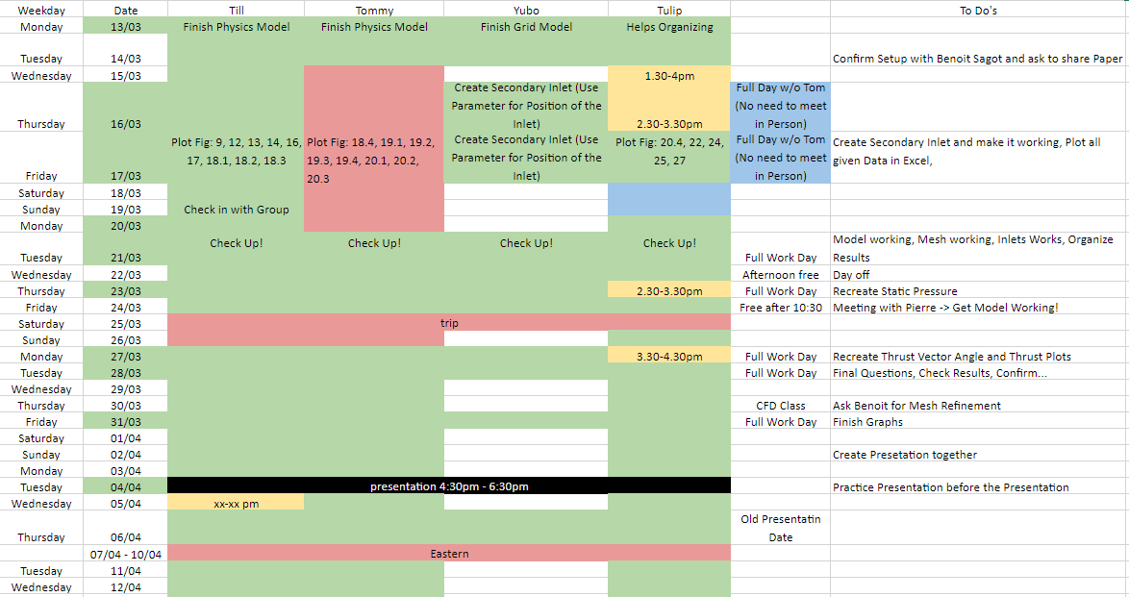
Internal Organization
4
Notes:
We store all our Data (Excel, Powerpoin, Word) directly in MS Teams -> Everybody can update Simutaneously. Whenever we create a new Star Version, we upload it so we can all use the newest and older Versions
We have a Timetable where we see what days we have to work on the Project and who will be there. We also assign Checkpoints so we stay on Track and fall too far behind
We also use a Meeting Log where we Recap all our Meetings, Check who was there and check what we did

Slide 6
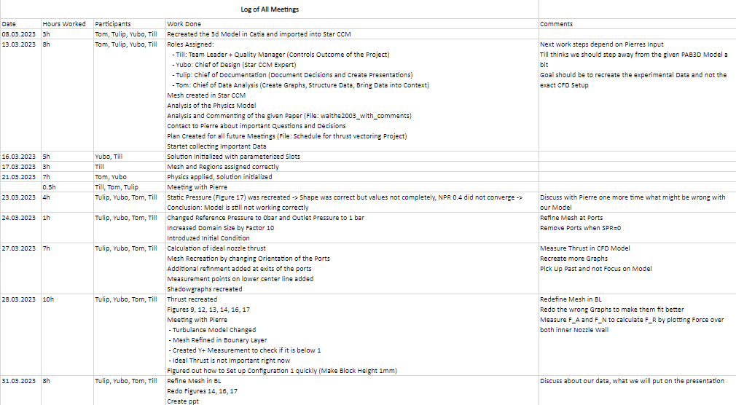
Internal Organization
Notes:
We store all our Data (Excel, Powerpoin, Word) directly in MS Teams -> Everybody can update Simutaneously. Whenever we create a new Star Version, we upload it so we can all use the newest and older Versions
We have a Timetable where we see what days we have to work on the Project and who will be there. We also assign Checkpoints so we stay on Track and fall too far behind
We aslo use a Meeting Log where we Recap all our Meetings, Check who was there and check what we did
Total Numbers of Work:

Slide 7
02
Introduction to Fluidic Thrust Vectoring
Purpose of a Nozzle and the Concept of Thrust Vectoring
5

Slide 8
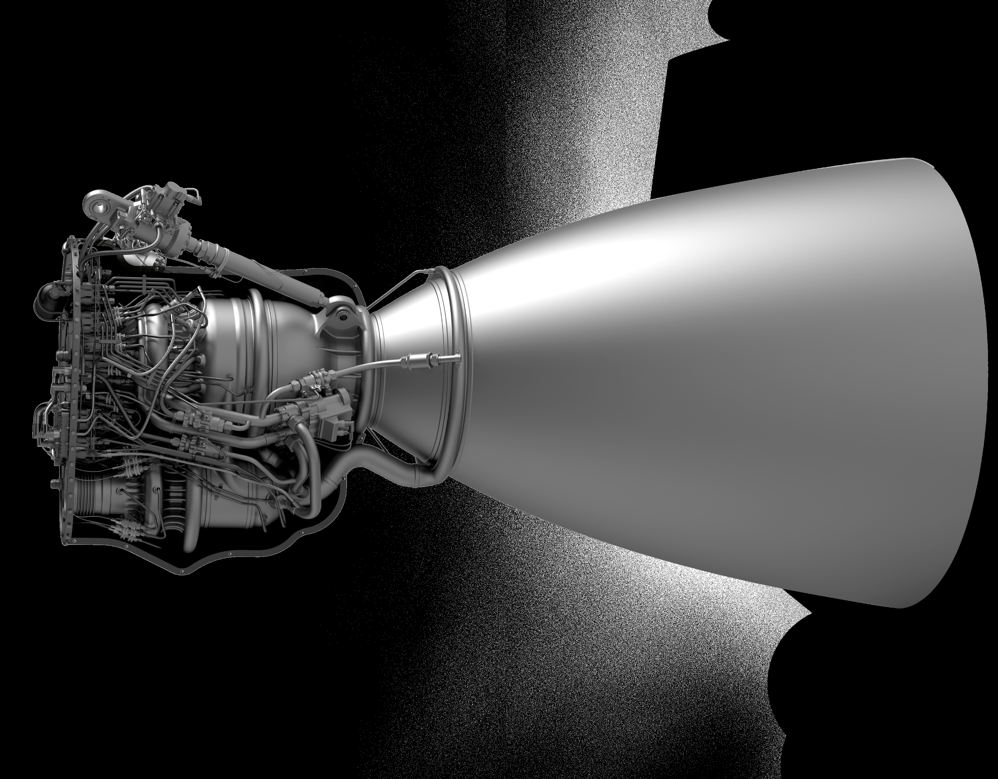
What is a Nozzle?
6
Notes:
What is a Nozzle:
Both Military and passenger Aircrafts use gas turbine engines (jet engines)
All jet engines have a nozzle that sits downstream of the power turbine
Nozzle produces thrust, Conduct the exhaust gases and control the mass flow rate through the engine -> Without a nozzle jet engines would not work
Why Thrust Vectoring:
Goal of a fighter aircraft design is to increase the agility, maneuverability and survivability
Thrust vectoring dramatically increases the agility and maneuverability -> The more the Thrust can be Vectored, the better it is for the aircraft
Why Fluidic Thrust Vectoring:
Mechanically Moving Flaps require heavy mechanical hardware, which adds Weight to the fighter and increases nozzle complexity, adding maintenance requirements
Alternative: shock vector fluidic thrust vectoring concept -> Shock vector is achieved by fluidic injection into the divergent portion of the nozzle, which causes a shock in the primary flow
Since there is no mechanical hardware other than control valves associated with fluidic thrust vectoring, the problems associated with movable flaps are eliminated
New Problems: secondary stream draws air from the primary air supply, which reduces the maximum possible thrust that can be achieved by the engine -> SPR must be as small as possible
Why multiple injection Ports:
The concept of utilizing multiple streams for fluidic thrust vectoring was conceived to maximize the pitch thrust vector angle without increasing the secondary flow requirement

Slide 9
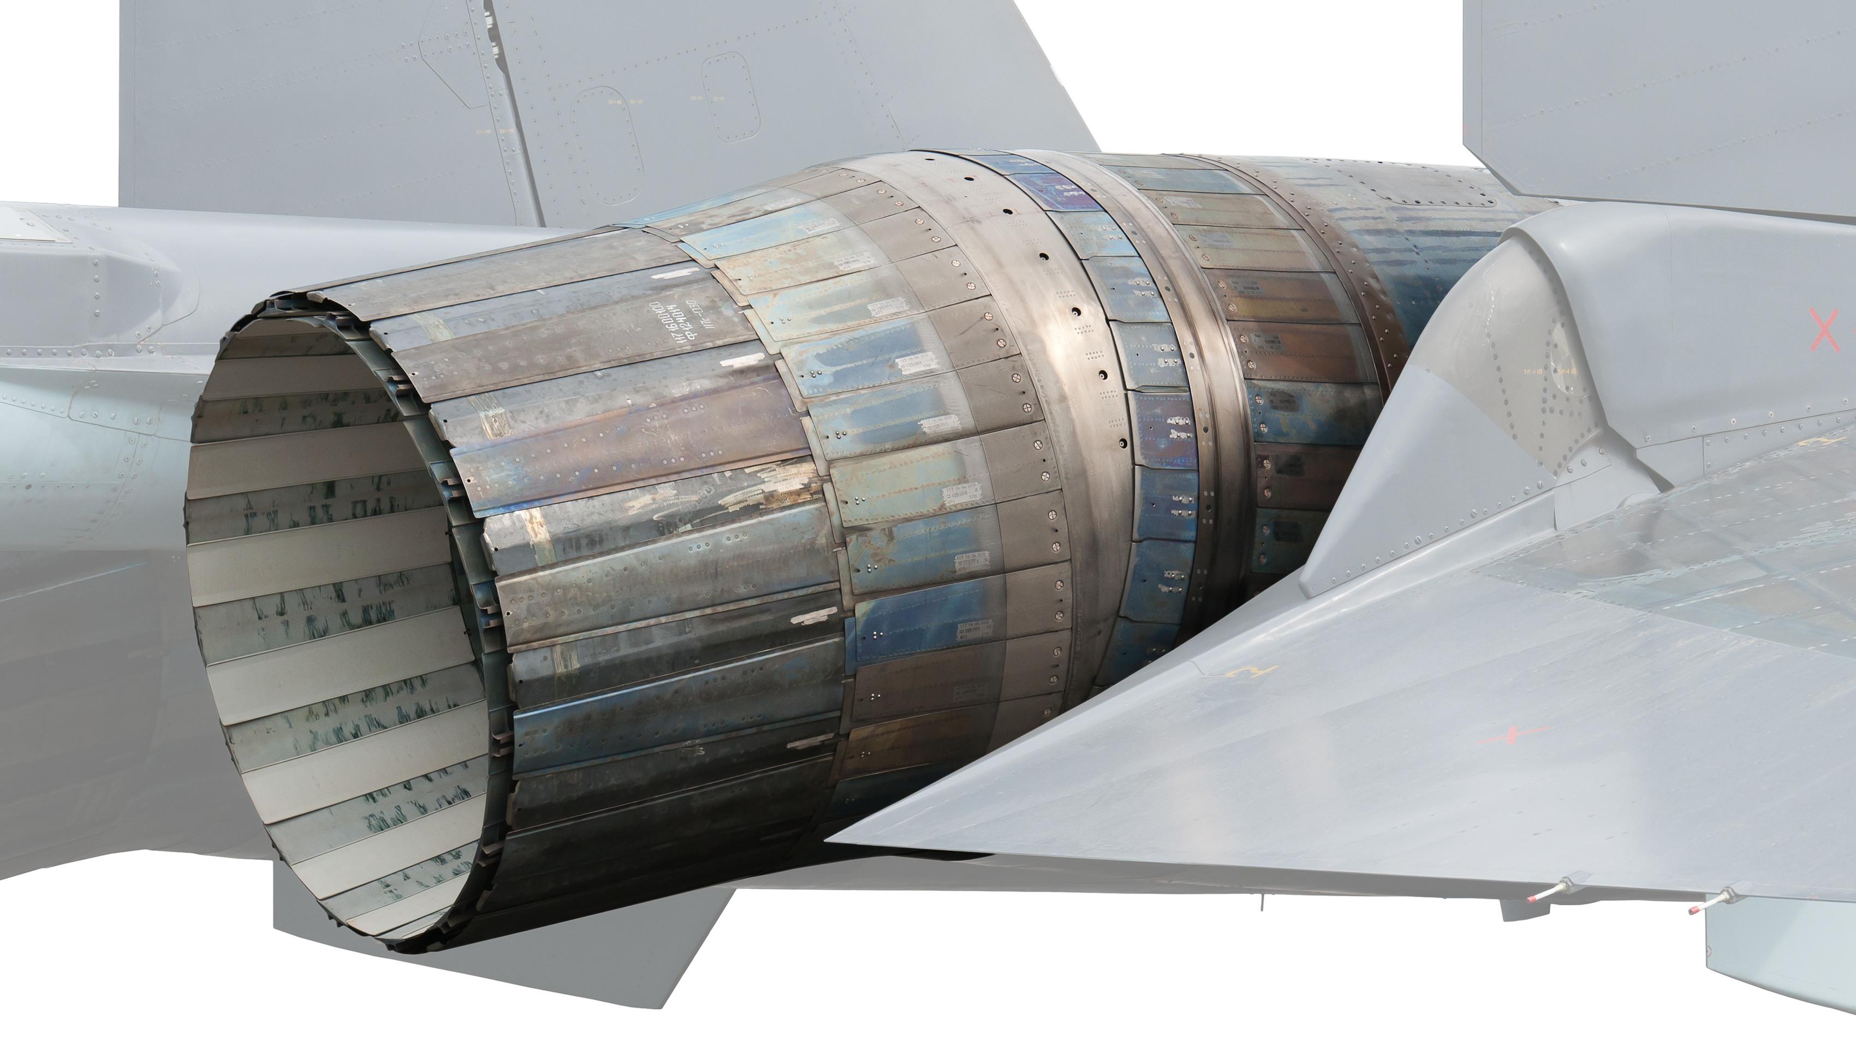
Why Thrust Vectoring?
The more thrust can be vectored, the better chance of their survival.
7
Notes:
What is a Nozzle:
Both Military and passenger Aircrafts use gas turbine enginges (jet engines)
All jet engines have a nozzle that sits downstream of the power turbine
Nozzle produces thrust, Conduct the exhaust gases and control the mass flow rate through the engine -> Without a nozzle jet engines would not work
Why Thrust Vectoring:
Goal of a fighter aircraft design is to increase the agility, maneuverability and survivability
Thrust vectoring dramatically increases the agility and maneuverability -> The more the Thrust can be Vectored, the better it is for the aircraft
Why Fluedic Thrust Vectoring:
Mechanically Moving Flaps require heavy mechanical hardware, which adds Weight to the fighter and increases nozzle complexity, adding maintenance requirements
Alternative: shock vector fluidic thrust vectoring concept -> Shock vector is achieved by fluidic injection into the divergent portion of the nozzle, which causes a shock in the primary flow
Since there is no mechanical hardware other than control valves associated with fluidic thrust vectoring, the problems associated with movable flaps are eliminated
New Problems: secondary stream draws air from the primary air supply, which reduces the maximum possible thrust that can be achieved by the engine -> SPR must be as small as possible
Why multiple injection Ports:
The concept of utilizing multiple streams for fluidic thrust vectoring was conceived to maximize the pitch thrust vector angle without increasing the secondary flow requirement

Slide 10
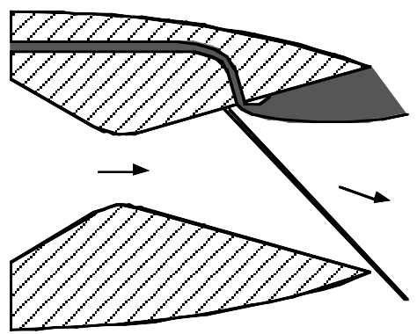
Fluidic Thrust Vectoring
SPR must be as small as possible.
8
Notes:
What is a Nozzle:
Both Military and passenger Aircrafts use gas turbine enginges (jet engines)
All jet engines have a nozzle that sits downstream of the power turbine
Nozzle produces thrust, Conduct the exhaust gases and control the mass flow rate through the engine -> Without a nozzle jet engines would not work
Why Thrust Vectoring:
Goal of a fighter aircraft design is to increase the agility, maneuverability and survivability
Thrust vectoring dramatically increases the agility and maneuverability -> The more the Thrust can be Vectored, the better it is for the aircraft
Why Fluedic Thrust Vectoring:
Mechanically Moving Flaps require heavy mechanical hardware, which adds Weight to the fighter and increases nozzle complexity, adding maintenance requirements
Alternative: shock vector fluidic thrust vectoring concept -> Shock vector is achieved by fluidic injection into the divergent portion of the nozzle, which causes a shock in the primary flow
Since there is no mechanical hardware other than control valves associated with fluidic thrust vectoring, the problems associated with movable flaps are eliminated
New Problems: secondary stream draws air from the primary air supply, which reduces the maximum possible thrust that can be achieved by the engine -> SPR must be as small as possible
Why multiple injection Ports:
The concept of utilizing multiple streams for fluidic thrust vectoring was conceived to maximize the pitch thrust vector angle without increasing the secondary flow requirement

Slide 11
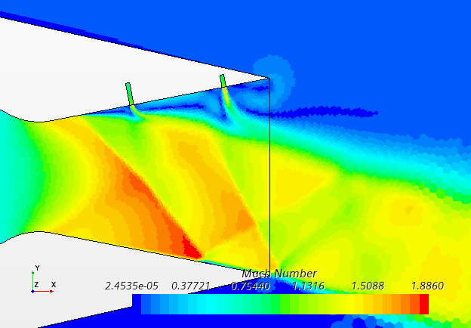
Multiple Injection Ports
9
Notes:
What is a Nozzle:
Both Military and passenger Aircrafts use gas turbine enginges (jet engines)
All jet engines have a nozzle that sits downstream of the power turbine
Nozzle produces thrust, Conduct the exhaust gases and control the mass flow rate through the engine -> Without a nozzle jet engines would not work
Why Thrust Vectoring:
Goal of a fighter aircraft design is to increase the agility, maneuverability and survivability
Thrust vectoring dramatically increases the agility and maneuverability -> The more the Thrust can be Vectored, the better it is for the aircraft
Why Fluedic Thrust Vectoring:
Mechanically Moving Flaps require heavy mechanical hardware, which adds Weight to the fighter and increases nozzle complexity, adding maintenance requirements
Alternative: shock vector fluidic thrust vectoring concept -> Shock vector is achieved by fluidic injection into the divergent portion of the nozzle, which causes a shock in the primary flow
Since there is no mechanical hardware other than control valves associated with fluidic thrust vectoring, the problems associated with movable flaps are eliminated
New Problems: secondary stream draws air from the primary air supply, which reduces the maximum possible thrust that can be achieved by the engine -> SPR must be as small as possible
Why multiple injection Ports:
The concept of utilizing multiple streams for fluidic thrust vectoring was conceived to maximize the pitch thrust vector angle without increasing the secondary flow requirement

Slide 12
Objectives for Part 1
Verify the concept of Fluidic Thrust Vectoring with CFD
Compare the Results to the Experimental Results from 2003
Judge the rationality and superiority of the performance
On this basis, we discuss some areas that could be improved, design a new nozzle, and verify its performance by CFD
Part I
Validation of the CFD tool
Numerical results ⟷ Experimental data
Part II
Design of nozzles with CFD
10

Slide 13
03
Experimental Investigation by Waithe and Deere
Experimental Cases and Configurations
10

Slide 14
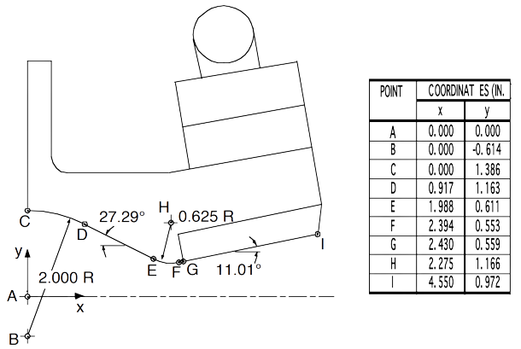
Nozzle Configuration
11
Notes:
Nozzle Configuration:
Usage of a non-axisymetric 2DCD Nozzle
Static Pressure Taps were installed on the upper and lower Center line
The upper divergent flap hardware of the nozzle was designed to accommodate fluidic injection in 5 different configurations
Slot Configuration:
The Upstream Slot moves further upstream
Configuration 1 has only 1 Slot with twice the Width
NPR (Nozzle Pressure Ratio) are differing from 2 to 10
SPR (Secondary Pressure Ratio) are differing from 0 to 1
(Extracted Data:
Static Pressure on upper and Lower Center Line
Resultant Thrust Consisting of Normal and Axial Thrust
Pitch Thrust Vector Angle calculated for Normal and Axial Thrust
The Resultant Thrust was also Compared to the Ideal Thrust which has not been confirmed yet because we are still missing Data for the Calculation of the Ideal Thrust
Shadow Graphs were Visualized)

Slide 15
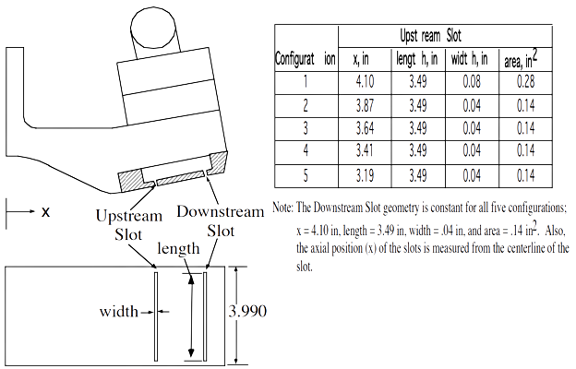
Slot Injection Configuration
12
Notes:
Nozzle Configuration:
Usage of a non-axisymetric 2DCD Nozzle
Static Pressure Taps were installed on the upper and lower Center line
The upper divergent flap hardware of the nozzle was designed to accommodate fluidic injection in 5 different configurations
Slot Configuration:
The Upstream Slot moves further upstream
Configuration 1 has only 1 Slot with twice the Width
NPR (Nozzle Pressure Ratio) are differing from 2 to 10
SPR (Secondary Pressure Ratio) are differing from 0 to 1
(Extracted Data:
Static Pressure on upper and Lower Center Line
Resultant Thrust Consisting of Normal and Axial Thrust
Pitch Thrust Vector Angle calculated for Normal and Axial Thrust
The Resultant Thrust was also Compared to the Ideal Thrust which has not been confirmed yet because we are still missing Data for the Calculation of the Ideal Thrust
Shadow Graphs were Visualized)

Slide 16
04
Catia and Star CCM+ Configuration
Workflow and Justification
13

Slide 17
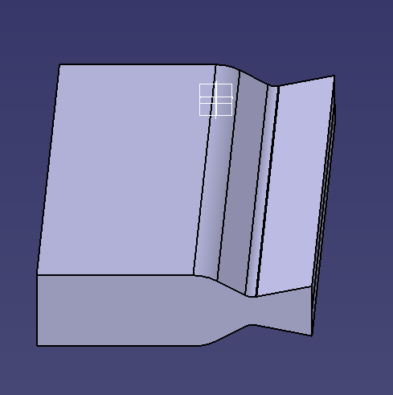
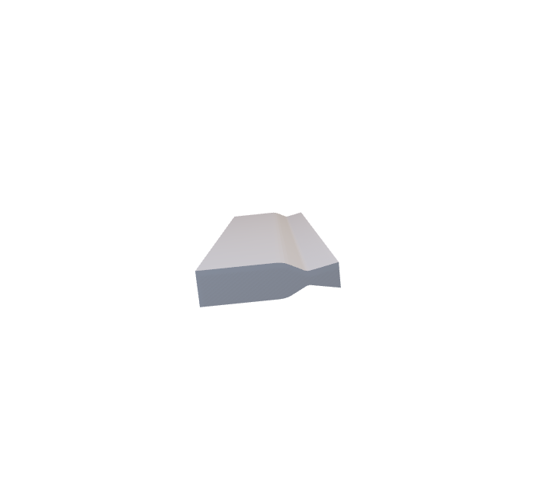
Catia Model of the Nozzle
14
Notes:
Methodology:
Like all the other Teams we first read the entire paper carefully and tried to understand as much as possible before starting the work on the Computer
Catia:
Creating the Geometry for the Project was in our case very simple. The Geometry of the Nozzle was precicely given in the paper
Exception: We don‘t really know how wide the Nozzle is (it is not axis-symmetrical) but it doesn‘t matter for our 2D Simulation -> 2D Simulation is best option because we cannot use axissymmetrical as it wouldnt show the thrust vectoring and a 3D Simuation would cost a lot more computational power and does not show any relevant effects we want to display (Setup the same as in the Paper)
We chose to make the Nozzle one Meter wide
(We also Created the „No slip Walls“ in Catia: Subtraction from the Windtunnel that represents a Geometry of a airplane that has the nozzle Mounted)
(A Refinement Area for the Flow directly Outside the Nozzle was also Created in Catia)
Star CCM:
Geometry:
Every other Geometry for the fluid domain was created directly in Star because we can then easily change the configuration without switching the Simulation (Parameterized in Star)
Geomitry Created in Star: Windtunnel, Slots, Refinement Areas for Nozzle and Slots
Imprint Function: Instead of „Unite“ we used the Imprint Function for Merging the diffenrent Part
1. We have direct Accessability to the planes that connect the Nozzle with the Slots and the Windtunnel -> Better for Measuring Thrust
2. We can make the Boundary Prism layer go over the Slot Inlets which provides a more accurate Mesh Refinement
Mesh:
(Mesh is different than in the Paper: We used a polygonal Mesher as it is just more modern and accurate)
It is important to make the Fluid Domain very large so the Stream out of the Nozzle has no Interaction with the Borders of the Fluid Domain. To keep computational cost low the base cize of the mesh is really large
Refinement in the Nozzle is important to catch the shocks created by the slots
Refinement of the exit stream to catch mach diamonds and transition to the surrounding flow
Slots have a seperate mesh with different base size and boundary layer because the geometry is very small compared to the rest of the geometry
BL goes over slot to cath the transition effects as good as possible and to avoid crudness on the corner
No slip walls have less defined BL to minimize computational cost
Y+ is below one where it is important (Essential for Spellart-Armas-Model)
Boundary Conditions:
Simple BC First: Outlet is a normal Pressure Outlet with no special Condition, Upper and Lower Boundary of the Fluid Domain are Symmetry Planes and No Slip Wall is a normal Wall
Inlets of the Fluid Domain are Velocity Inlets with a low Velocity Number (10 m/s) so it does not affect the stream coming out of the nozzle (No Number given in the paper)
Initial Conditions: Atmospheric Pressure to 1bar (Simulation is more stable) and Reference Pressure to 0 (Important for measuring the absoute Pressure not the relative Pressure)
In the Paper only the NPR and SPR is given -> Stagnation Inlets must be Chosen for Nozzle Inlet and the Inlets of the Slots (Temperature 300K 8No number given but we know it is a cold jet) and Pressure varying on the current Configuration) -> It is important to start the Simulation with moderate Values and do a few step Build Up so Simulation doesn‘t crash
The Imprint Area to the Windtunnel is a Free Flow on both sides so no Boundary Layer is created and normal Flow is Possible
The Imprint Area to the slots on the Nozzle side is a Wall to keep the BL inside the Nozzle steady and on the Lot side it is a free Flow to make the secondary Stream go out of the slots
(In General: All BC‘s and Inital Conditions that we have no Information about was left as the standard values)
Governing Equations:
(2D Flow: 2D Simulation)
(Steady: Simulation is Steady)
Gas + Ideal Gas: Normal Air is used in the Experiments
(Gradients: ???)
Coupled Flow: Much more stable in Supersonic Flows with shocks (standard for supersonic flows)
Spalart-Allmaras Turbulence Model:
Simplified Reynolds averaged Navier Stokes:
All y+ Wall Treatment:
Extracted Data:
Mach Scene shows the Flow Inside and outside of the Nozzle and is important for Visual Confimation that the Model is working
A total of 50 Measurement Points is used to measure the static Pressure on the Nozzle Walls (Positions are derived from the Figures given in the Paper)
Normal and Axial Thrust was gathered over the Imprint Area to the Windtunnel (most accurate) -> Before it was Measured by the Force over the Upper and Lower Nozzle Wall (Less Accurate)
(When using configuration 1, axial and normal thrust was used to calculate the angle of the thrust. When gathering data on configuration five, force on the upper and lower nozzle sections was used to calculate the thrust angle)
Mass Flow was gathered over the Stagnation Inlet of the Nozzle and the Imprint Areas the the Slots and the Windtunnel to confirm that the Numbers add up (Mass Flow must be constant through the Nozzle)
Shadowgraphs were created to directly compare them to the Shadowgraphs of the Experiment
In order to post process the data we often had to do Calculations with the raw Data to get the Thrust Vector Angle, The Ideal Thrust (Theoretically) or the resultant Thrust

Slide 18
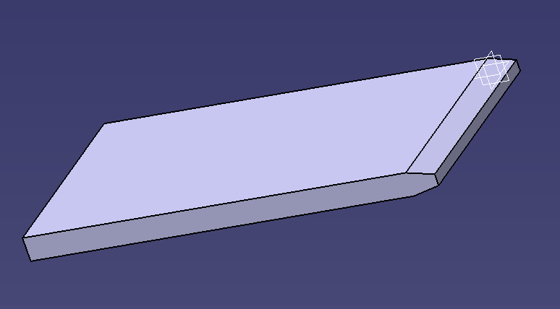
Catia Model of the No Slip Walls
Notes:
Methodology:
Like all the other Teams we first read the entire paper carefully and tried to understand as much as possible before starting the work on the Computer
Catia:
Creating the Geometry for the Project was in our case very simple. The Geometry of the Nozzle was precicely given in the paper
Exception: We don‘t really know how wide the Nozzle is (it is not axis-symmetrical) but it doesn‘t matter for our 2D Simulation -> 2D Simulation is best option because we cannot use axissymmetrical as it wouldnt show the thrust vectoring and a 3D Simuation would cost a lot more computational power and does not show any relevant effects we want to display (Setup the same as in the Paper)
We chose to make the Nozzle one Meter wide
We also Created the „No slip Walls“ in Catia: Subtraction from the Windtunnel that represents a Geometry of an airplane that has the nozzle Mounted
A Refinement Area for the Flow directly Outside the Nozzle was also Created in Catia
Star CCM:
Geometry:
Every other Geometry for the fluid domain was created directly in Star because we can then easily change the configuration without switching the Simulation
Geomitry Created in Star: Windtunnel, Slots, Refinement Areas for Nozzle and Slots
Imprint Function: Instead of „Unite“ we used the Imprint Function for Merging the diffenrent Part
1. We have direct Accessability to the planes that connect the Nozzle with the Slots and the Windtunnel -> Better for Measuring Thrust
2. We can make the Boundary Prism layer go over the Slot Inlets which provides a more accurate Mesh Refinement
Mesh:
Mesh is different than in the Paper: We used a polygonal Mesher as it is just more modern and accurate
It is important to make the Fluid Domain very large so the Stream out of the Nozzle has no ???-Effects with the Borders of the Fluid Domain. To keep computational cost low the base cize of the mesh is reallylarge
Refinement in the Nozzle is important to catch the shocks created by the slots
Refinement of the exit stream to catch mash diamonds and transition to the surrounding flow
Slots have a seperate mesh with different base size and boundary layer because the geometry is very small compared to the rest of the geometry
BL goes over slot to cath the transition effects as good as possible and to avoid crudness on the corner
No slip walls have less defined BL to minimize computational cost
Y+ is below one where it is important (Essential for Spellart-Armas-Model)
Boundary Conditions:
Simple BC First: Outlet is a normal Pressure Outlet with no special Condition, Upper and Lower Boundary of the Fluid Domain are Symmetry Planes and No Slip Wall is a normal Wall
Inlets of the Fluid Domain are Velocity Inlets with a low Velocity Number (10 m/s) so it does not affect the stream coming out of the nozzle (No Number given in the paper)
Initial Conditions: Atmospheric Pressure to 1bar (Simulation is more stable) and Reference Pressure to 0 (Important for measuring the absoute Pressure not the relative Pressure)
In the Paper only the NPR and SPR is given -> Stagnation Inlets must be Chosen for Nozzle Inlet and the Inlets of the Slots (Temperature 300K 8No number given but we know it is a cold jet) and Pressure varying on the current Configuration) -> It is important to start the Simulation with moderate Values and do a few step Build Up so Simulation doesn‘t crash
The Imprint Area to the Windtunnel is a Free Flow on both sides so no Boundary Layer is created and normal Flow is Possible
The Imprint Area to the slots on the Nozzle side is a Wall to keep the BL inside the Nozzle steady and on the Lot side it is a free Flow to make the secondary Stream go out of the slots
(In General: All BC‘s and Inital Conditions that we have no Information about was left as the standard values)
Governing Equations:
(2D Flow: 2D Simulation)
(Steady: Simulation is Steady)
Gas + Ideal Gas: Normal Air is used in the Experiments
(Gradients: ???)
Coupled Flow: Much more stable in Supersonic Flows with shocks (standard for supersonic flows)
Spalart-Allmaras Turbulence Model:
Simplified Reynolds averaged Navier Stokes:
All y+ Wall Treatment:
Extracted Data:
Mach Scene shows the Flow Inside and outside of the Nozzle and is important for Visual Confimation that the Model is working
A total of 50 Measurement Points is used to measure the static Pressure on the Nozzle Walls (Positions are derived from the Figures given in the Paper)
Normal and Axial Thrust was gathered over the Imprint Area to the Windtunnel (most accurate) -> Before it was Measured by the Force over the Upper and Lower Nozzle Wall (Less Accurate)
(When using configuration 1, axial and normal thrust was used to calculate the angle of the thrust. When gathering data on configuration five, force on the upper and lower nozzle sections was used to calculate the thrust angle)
Mass Flow was gathered over the Stagnation Inlet of the Nozzle and the Imprint Areas the the Slots and the Windtunnel to confirm that the Numbers add up (Mass Flow must be constant through the Nozzle)
Shadowgraphs were created to directly compare them to the Shadowgraphs of the Experiment
In order to post process the data we often had to do Calculations with the raw Data to get the Thrust Vector Angle, The Ideal Thrust (Theoretically) or the resultant Thrust

Slide 19
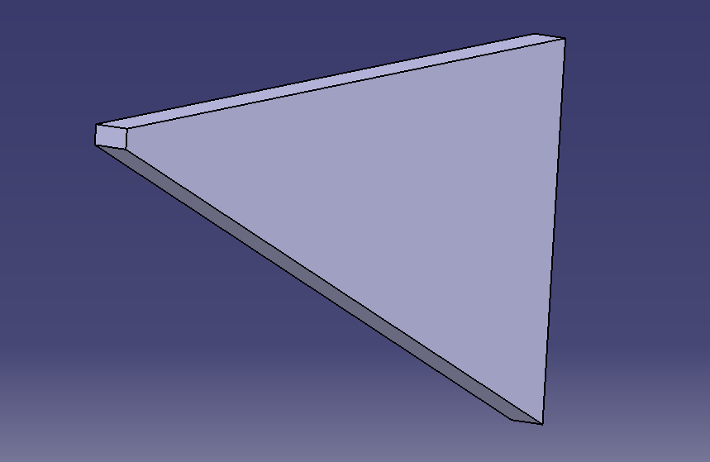
Catia Model of the Refinement Area
Notes:
Methodology:
Like all the other Teams we first read the entire paper carefully and tried to understand as much as possible before starting the work on the Computer
Catia:
Creating the Geometry for the Project was in our case very simple. The Geometry of the Nozzle was precicely given in the paper
Exception: We don‘t really know how wide the Nozzle is (it is not axis-symmetrical) but it doesn‘t matter for our 2D Simulation -> 2D Simulation is best option because we cannot use axissymmetrical as it wouldnt show the thrust vectoring and a 3D Simuation would cost a lot more computational power and does not show any relevant effects we want to display (Setup the same as in the Paper)
We chose to make the Nozzle one Meter wide
(We also Created the „No slip Walls“ in Catia: Subtraction from the Windtunnel that represents a Geometry of a airplane that has the nozzle Mounted)
(A Refinement Area for the Flow directly Outside the Nozzle was also Created in Catia)
Star CCM:
Geometry:
Every other Geometry for the fluid domain was created directly in Star because we can then easily change the configuration without switching the Simulation (Parameterized in Star)
Geomitry Created in Star: Windtunnel, Slots, Refinement Areas for Nozzle and Slots
Imprint Function: Instead of „Unite“ we used the Imprint Function for Merging the diffenrent Part
1. We have direct Accessability to the planes that connect the Nozzle with the Slots and the Windtunnel -> Better for Measuring Thrust
2. We can make the Boundary Prism layer go over the Slot Inlets which provides a more accurate Mesh Refinement
Mesh:
(Mesh is different than in the Paper: We used a polygonal Mesher as it is just more modern and accurate)
It is important to make the Fluid Domain very large so the Stream out of the Nozzle has no Interaction with the Borders of the Fluid Domain. To keep computational cost low the base cize of the mesh is really large
Refinement in the Nozzle is important to catch the shocks created by the slots
Refinement of the exit stream to catch mach diamonds and transition to the surrounding flow
Slots have a seperate mesh with different base size and boundary layer because the geometry is very small compared to the rest of the geometry
BL goes over slot to cath the transition effects as good as possible and to avoid crudness on the corner
No slip walls have less defined BL to minimize computational cost
Y+ is below one where it is important (Essential for Spellart-Armas-Model)
Boundary Conditions:
Simple BC First: Outlet is a normal Pressure Outlet with no special Condition, Upper and Lower Boundary of the Fluid Domain are Symmetry Planes and No Slip Wall is a normal Wall
Inlets of the Fluid Domain are Velocity Inlets with a low Velocity Number (10 m/s) so it does not affect the stream coming out of the nozzle (No Number given in the paper)
Initial Conditions: Atmospheric Pressure to 1bar (Simulation is more stable) and Reference Pressure to 0 (Important for measuring the absoute Pressure not the relative Pressure)
In the Paper only the NPR and SPR is given -> Stagnation Inlets must be Chosen for Nozzle Inlet and the Inlets of the Slots (Temperature 300K 8No number given but we know it is a cold jet) and Pressure varying on the current Configuration) -> It is important to start the Simulation with moderate Values and do a few step Build Up so Simulation doesn‘t crash
The Imprint Area to the Windtunnel is a Free Flow on both sides so no Boundary Layer is created and normal Flow is Possible
The Imprint Area to the slots on the Nozzle side is a Wall to keep the BL inside the Nozzle steady and on the Lot side it is a free Flow to make the secondary Stream go out of the slots
(In General: All BC‘s and Inital Conditions that we have no Information about was left as the standard values)
Governing Equations:
(2D Flow: 2D Simulation)
(Steady: Simulation is Steady)
Gas + Ideal Gas: Normal Air is used in the Experiments
(Gradients: ???)
Coupled Flow: Much more stable in Supersonic Flows with shocks (standard for supersonic flows)
Spalart-Allmaras Turbulence Model:
Simplified Reynolds averaged Navier Stokes:
All y+ Wall Treatment:
Extracted Data:
Mach Scene shows the Flow Inside and outside of the Nozzle and is important for Visual Confimation that the Model is working
A total of 50 Measurement Points is used to measure the static Pressure on the Nozzle Walls (Positions are derived from the Figures given in the Paper)
Normal and Axial Thrust was gathered over the Imprint Area to the Windtunnel (most accurate) -> Before it was Measured by the Force over the Upper and Lower Nozzle Wall (Less Accurate)
(When using configuration 1, axial and normal thrust was used to calculate the angle of the thrust. When gathering data on configuration five, force on the upper and lower nozzle sections was used to calculate the thrust angle)
Mass Flow was gathered over the Stagnation Inlet of the Nozzle and the Imprint Areas the the Slots and the Windtunnel to confirm that the Numbers add up (Mass Flow must be constant through the Nozzle)
Shadowgraphs were created to directly compare them to the Shadowgraphs of the Experiment
In order to post process the data we often had to do Calculations with the raw Data to get the Thrust Vector Angle, The Ideal Thrust (Theoretically) or the resultant Thrust

Slide 20
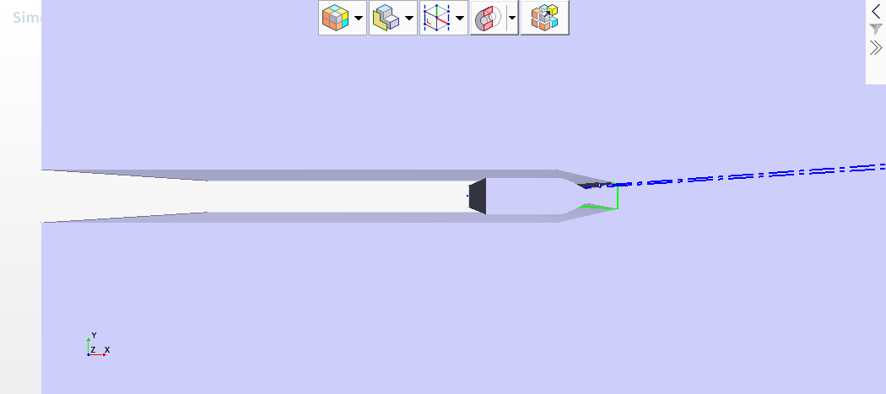
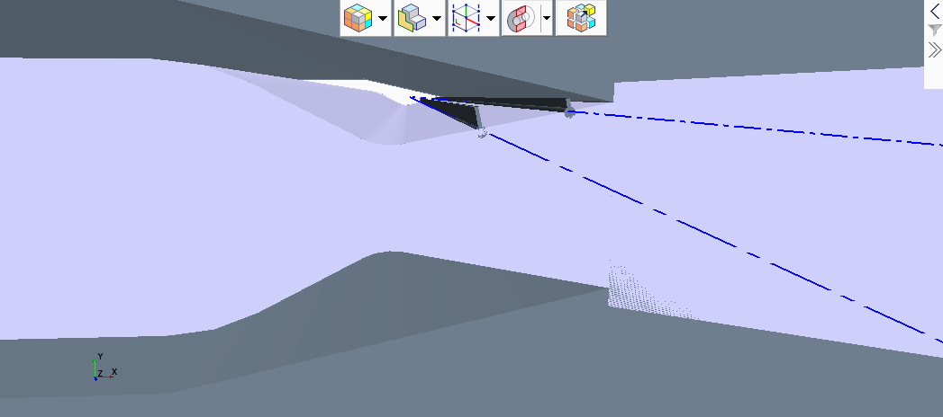
Star CCM – Geometry Final 3D Model in Star
15
Notes:
Methodology:
Like all the other Teams we first read the entire paper carefully and tried to understand as much as possible before starting the work on the Computer
Catia:
Creating the Geometry for the Project was in our case very simple. The Geometry of the Nozzle was precicely given in the paper
Exception: We don‘t really know how wide the Nozzle is (it is not axis-symmetrical) but it doesn‘t matter for our 2D Simulation -> 2D Simulation is best option because we cannot use axissymmetrical as it wouldnt show the thrust vectoring and a 3D Simuation would cost a lot more computational power and does not show any relevant effects we want to display (Setup the same as in the Paper)
We chose to make the Nozzle one Meter wide
We also Created the „No slip Walls“ in Catia: Subtraction from the Windtunnel that represents a Geometry of a airplane that has the nozzle Mounted
A Refinement Area for the Flow directly Outside the Nozzle was also Created in Catia
Star CCM:
Geometry:
Every other Geometry for the fluid domain was created directly in Star because we can then easily change the configuration without switching the Simulation (Parameterized in Star)
(Geomitry Created in Star: Windtunnel, Slots, Refinement Areas for Nozzle and Slots)
Imprint Function: Instead of „Unite“ we used the Imprint Function for Merging the diffenrent Part
1. We have direct Accessability to the planes that connect the Nozzle with the Slots and the Windtunnel -> Better for Measuring Thrust
2. We can make the Boundary Prism layer go over the Slot Inlets which provides a more accurate Mesh Refinement
Mesh:
(Mesh is different than in the Paper: We used a polygonal Mesher as it is just more modern and accurate)
It is important to make the Fluid Domain very large so the Stream out of the Nozzle has no Interaction with the Borders of the Fluid Domain. To keep computational cost low the base cize of the mesh is really large
Refinement in the Nozzle is important to catch the shocks created by the slots
Refinement of the exit stream to catch mach diamonds and transition to the surrounding flow
Slots have a seperate mesh with different base size and boundary layer because the geometry is very small compared to the rest of the geometry
BL goes over slot to cath the transition effects as good as possible and to avoid crudness on the corner
No slip walls have less defined BL to minimize computational cost
Y+ is below one where it is important (Essential for Spellart-Armas-Model)
Boundary Conditions:
Simple BC First: Outlet is a normal Pressure Outlet with no special Condition, Upper and Lower Boundary of the Fluid Domain are Symmetry Planes and No Slip Wall is a normal Wall
Inlets of the Fluid Domain are Velocity Inlets with a low Velocity Number (10 m/s) so it does not affect the stream coming out of the nozzle (No Number given in the paper)
Initial Conditions: Atmospheric Pressure to 1bar (Simulation is more stable) and Reference Pressure to 0 (Important for measuring the absoute Pressure not the relative Pressure)
In the Paper only the NPR and SPR is given -> Stagnation Inlets must be Chosen for Nozzle Inlet and the Inlets of the Slots (Temperature 300K 8No number given but we know it is a cold jet) and Pressure varying on the current Configuration) -> It is important to start the Simulation with moderate Values and do a few step Build Up so Simulation doesn‘t crash
The Imprint Area to the Windtunnel is a Free Flow on both sides so no Boundary Layer is created and normal Flow is Possible
The Imprint Area to the slots on the Nozzle side is a Wall to keep the BL inside the Nozzle steady and on the Lot side it is a free Flow to make the secondary Stream go out of the slots
(In General: All BC‘s and Inital Conditions that we have no Information about was left as the standard values)
Governing Equations:
(2D Flow: 2D Simulation)
(Steady: Simulation is Steady)
Gas + Ideal Gas: Normal Air is used in the Experiments
(Gradients: ???)
Coupled Flow: Much more stable in Supersonic Flows with shocks (standard for supersonic flows)
Spalart-Allmaras Turbulence Model:
Simplified Reynolds averaged Navier Stokes:
All y+ Wall Treatment:
Extracted Data:
Mach Scene shows the Flow Inside and outside of the Nozzle and is important for Visual Confimation that the Model is working
A total of 50 Measurement Points is used to measure the static Pressure on the Nozzle Walls (Positions are derived from the Figures given in the Paper)
Normal and Axial Thrust was gathered over the Imprint Area to the Windtunnel (most accurate) -> Before it was Measured by the Force over the Upper and Lower Nozzle Wall (Less Accurate)
(When using configuration 1, axial and normal thrust was used to calculate the angle of the thrust. When gathering data on configuration five, force on the upper and lower nozzle sections was used to calculate the thrust angle)
Mass Flow was gathered over the Stagnation Inlet of the Nozzle and the Imprint Areas the the Slots and the Windtunnel to confirm that the Numbers add up (Mass Flow must be constant through the Nozzle)
Shadowgraphs were created to directly compare them to the Shadowgraphs of the Experiment
In order to post process the data we often had to do Calculations with the raw Data to get the Thrust Vector Angle, The Ideal Thrust (Theoretically) or the resultant Thrust

Slide 21
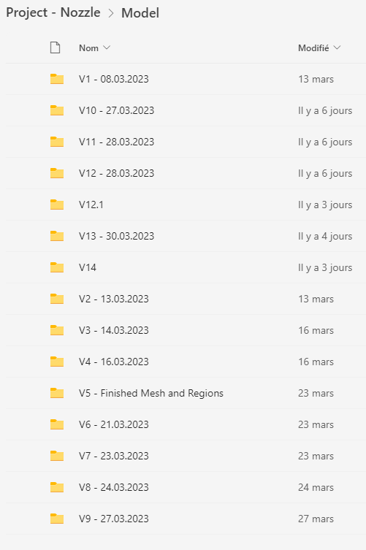
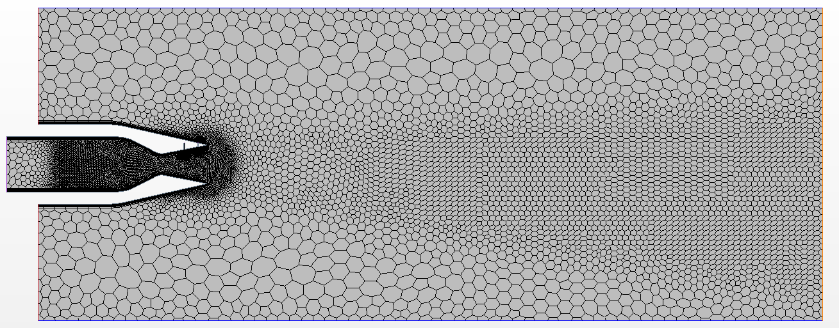
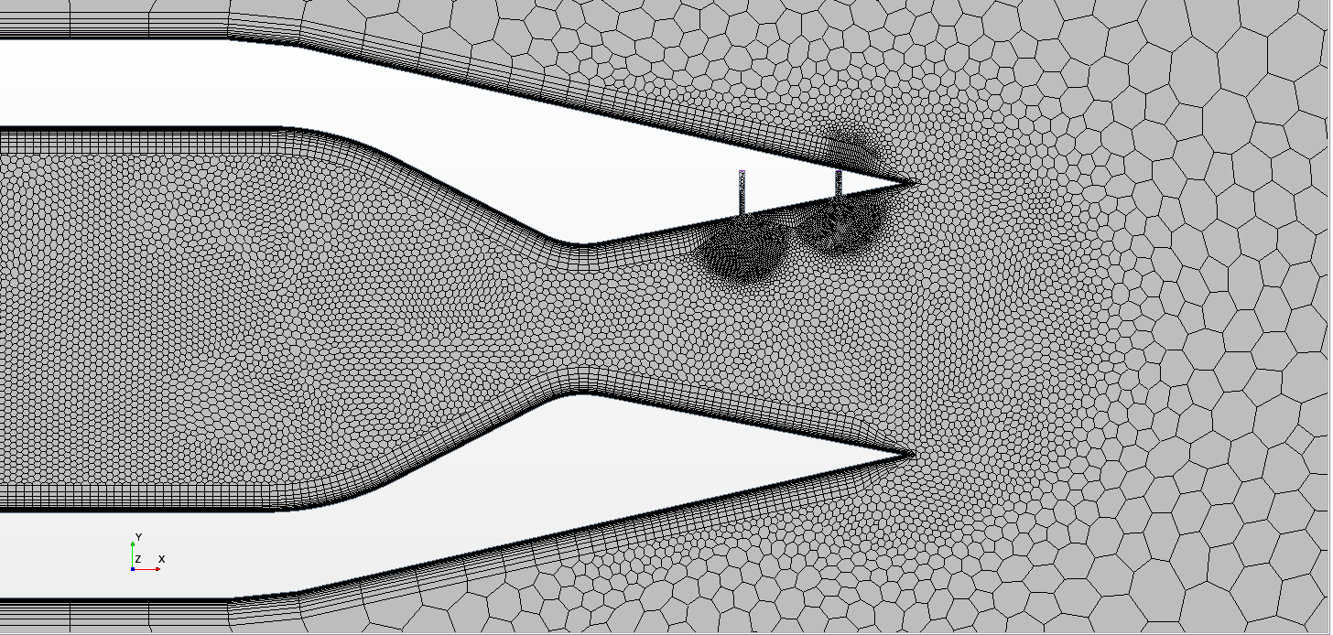
Star CCM – Mesh Original V1 Mesh
16
Notes:
Methodology:
Like all the other Teams we first read the entire paper carefully and tried to understand as much as possible before starting the work on the Computer
Catia:
Creating the Geometry for the Project was in our case very simple. The Geometry of the Nozzle was precicely given in the paper
Exception: We don‘t really know how wide the Nozzle is (it is not axis-symmetrical) but it doesn‘t matter for our 2D Simulation -> 2D Simulation is best option because we cannot use axissymmetrical as it wouldnt show the thrust vectoring and a 3D Simuation would cost a lot more computational power and does not show any relevant effects we want to display (Setup the same as in the Paper)
We chose to make the Nozzle one Meter wide
We also Created the „No slip Walls“ in Catia: Subtraction from the Windtunnel that represents a Geometry of a airplane that has the nozzle Mounted
A Refinement Area for the Flow directly Outside the Nozzle was also Created in Catia
Star CCM:
Geometry:
Every other Geometry for the fluid domain was created directly in Star because we can then easily change the configuration without switching the Simulation (Parameterized in Star)
Geomitry Created in Star: Windtunnel, Slots, Refinement Areas for Nozzle and Slots
Imprint Function: Instead of „Unite“ we used the Imprint Function for Merging the diffenrent Part
1. We have direct Accessability to the planes that connect the Nozzle with the Slots and the Windtunnel -> Better for Measuring Thrust
2. We can make the Boundary Prism layer go over the Slot Inlets which provides a more accurate Mesh Refinement
Mesh:
(Mesh is different than in the Paper: We used a polygonal Mesher as it is just more modern and accurate)
It is important to make the Fluid Domain very large so the Stream out of the Nozzle has no Interaction with the Borders of the Fluid Domain. To keep computational cost low the base cize of the mesh is really large
Refinement in the Nozzle is important to catch the shocks created by the slots
Refinement of the exit stream to catch mach diamonds and transition to the surrounding flow
Slots have a seperate mesh with different base size and boundary layer because the geometry is very small compared to the rest of the geometry
BL goes over slot to cath the transition effects as good as possible and to avoid crudness on the corner
No slip walls have less defined BL to minimize computational cost
Y+ is below one where it is important (Essential for Spellart-Armas-Model)
Boundary Conditions:
Simple BC First: Outlet is a normal Pressure Outlet with no special Condition, Upper and Lower Boundary of the Fluid Domain are Symmetry Planes and No Slip Wall is a normal Wall
Inlets of the Fluid Domain are Velocity Inlets with a low Velocity Number (10 m/s) so it does not affect the stream coming out of the nozzle (No Number given in the paper)
Initial Conditions: Atmospheric Pressure to 1bar (Simulation is more stable) and Reference Pressure to 0 (Important for measuring the absoute Pressure not the relative Pressure)
In the Paper only the NPR and SPR is given -> Stagnation Inlets must be Chosen for Nozzle Inlet and the Inlets of the Slots (Temperature 300K 8No number given but we know it is a cold jet) and Pressure varying on the current Configuration) -> It is important to start the Simulation with moderate Values and do a few step Build Up so Simulation doesn‘t crash
The Imprint Area to the Windtunnel is a Free Flow on both sides so no Boundary Layer is created and normal Flow is Possible
The Imprint Area to the slots on the Nozzle side is a Wall to keep the BL inside the Nozzle steady and on the Lot side it is a free Flow to make the secondary Stream go out of the slots
(In General: All BC‘s and Inital Conditions that we have no Information about was left as the standard values)
Governing Equations:
(2D Flow: 2D Simulation)
(Steady: Simulation is Steady)
Gas + Ideal Gas: Normal Air is used in the Experiments
(Gradients: ???)
Coupled Flow: Much more stable in Supersonic Flows with shocks (standard for supersonic flows)
Spalart-Allmaras Turbulence Model:
Simplified Reynolds averaged Navier Stokes:
All y+ Wall Treatment:
Extracted Data:
Mach Scene shows the Flow Inside and outside of the Nozzle and is important for Visual Confimation that the Model is working
A total of 50 Measurement Points is used to measure the static Pressure on the Nozzle Walls (Positions are derived from the Figures given in the Paper)
Normal and Axial Thrust was gathered over the Imprint Area to the Windtunnel (most accurate) -> Before it was Measured by the Force over the Upper and Lower Nozzle Wall (Less Accurate)
(When using configuration 1, axial and normal thrust was used to calculate the angle of the thrust. When gathering data on configuration five, force on the upper and lower nozzle sections was used to calculate the thrust angle)
Mass Flow was gathered over the Stagnation Inlet of the Nozzle and the Imprint Areas the the Slots and the Windtunnel to confirm that the Numbers add up (Mass Flow must be constant through the Nozzle)
Shadowgraphs were created to directly compare them to the Shadowgraphs of the Experiment
In order to post process the data we often had to do Calculations with the raw Data to get the Thrust Vector Angle, The Ideal Thrust (Theoretically) or the resultant Thrust

Slide 22
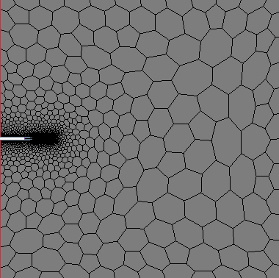
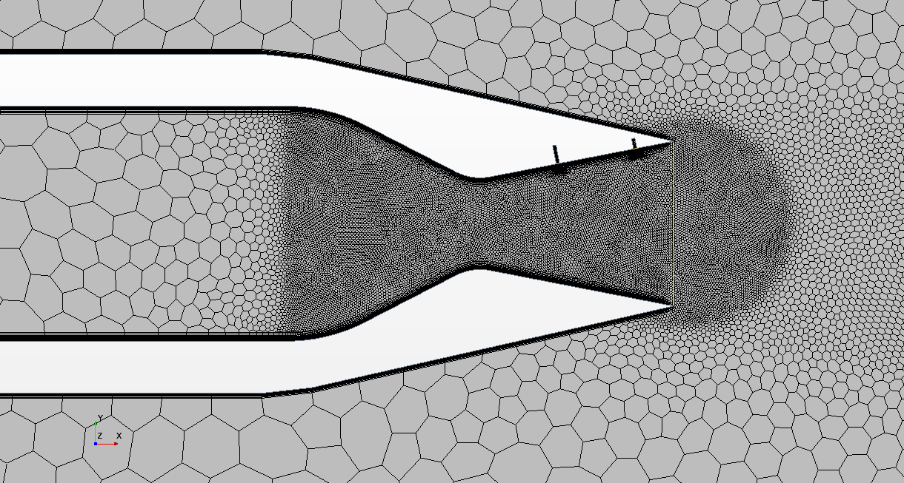
Star CCM – Mesh Final V15 Mesh
16
Notes:
Methodology:
Like all the other Teams we first read the entire paper carefully and tried to understand as much as possible before starting the work on the Computer
Catia:
Creating the Geometry for the Project was in our case very simple. The Geometry of the Nozzle was precicely given in the paper
Exception: We don‘t really know how wide the Nozzle is (it is not axis-symmetrical) but it doesn‘t matter for our 2D Simulation -> 2D Simulation is best option because we cannot use axissymmetrical as it wouldnt show the thrust vectoring and a 3D Simuation would cost a lot more computational power and does not show any relevant effects we want to display (Setup the same as in the Paper)
We chose to make the Nozzle one Meter wide
We also Created the „No slip Walls“ in Catia: Subtraction from the Windtunnel that represents a Geometry of a airplane that has the nozzle Mounted
A Refinement Area for the Flow directly Outside the Nozzle was also Created in Catia
Star CCM:
Geometry:
Every other Geometry for the fluid domain was created directly in Star because we can then easily change the configuration without switching the Simulation (Parameterized in Star)
Geomitry Created in Star: Windtunnel, Slots, Refinement Areas for Nozzle and Slots
Imprint Function: Instead of „Unite“ we used the Imprint Function for Merging the diffenrent Part
1. We have direct Accessability to the planes that connect the Nozzle with the Slots and the Windtunnel -> Better for Measuring Thrust
2. We can make the Boundary Prism layer go over the Slot Inlets which provides a more accurate Mesh Refinement
Mesh:
(Mesh is different than in the Paper: We used a polygonal Mesher as it is just more modern and accurate)
It is important to make the Fluid Domain very large so the Stream out of the Nozzle has no Interaction with the Borders of the Fluid Domain. To keep computational cost low the base cize of the mesh is really large
Refinement in the Nozzle is important to catch the shocks created by the slots
Refinement of the exit stream to catch mach diamonds and transition to the surrounding flow
Slots have a seperate mesh with different base size and boundary layer because the geometry is very small compared to the rest of the geometry
BL goes over slot to cath the transition effects as good as possible and to avoid crudness on the corner
No slip walls have less defined BL to minimize computational cost
Y+ is below one where it is important (Essential for Spellart-Armas-Model)
Boundary Conditions:
Simple BC First: Outlet is a normal Pressure Outlet with no special Condition, Upper and Lower Boundary of the Fluid Domain are Symmetry Planes and No Slip Wall is a normal Wall
Inlets of the Fluid Domain are Velocity Inlets with a low Velocity Number (10 m/s) so it does not affect the stream coming out of the nozzle (No Number given in the paper)
Initial Conditions: Atmospheric Pressure to 1bar (Simulation is more stable) and Reference Pressure to 0 (Important for measuring the absoute Pressure not the relative Pressure)
In the Paper only the NPR and SPR is given -> Stagnation Inlets must be Chosen for Nozzle Inlet and the Inlets of the Slots (Temperature 300K 8No number given but we know it is a cold jet) and Pressure varying on the current Configuration) -> It is important to start the Simulation with moderate Values and do a few step Build Up so Simulation doesn‘t crash
The Imprint Area to the Windtunnel is a Free Flow on both sides so no Boundary Layer is created and normal Flow is Possible
The Imprint Area to the slots on the Nozzle side is a Wall to keep the BL inside the Nozzle steady and on the Lot side it is a free Flow to make the secondary Stream go out of the slots
(In General: All BC‘s and Inital Conditions that we have no Information about was left as the standard values)
Governing Equations:
(2D Flow: 2D Simulation)
(Steady: Simulation is Steady)
Gas + Ideal Gas: Normal Air is used in the Experiments
(Gradients: ???)
Coupled Flow: Much more stable in Supersonic Flows with shocks (standard for supersonic flows)
Spalart-Allmaras Turbulence Model:
Simplified Reynolds averaged Navier Stokes:
All y+ Wall Treatment:
Extracted Data:
Mach Scene shows the Flow Inside and outside of the Nozzle and is important for Visual Confimation that the Model is working
A total of 50 Measurement Points is used to measure the static Pressure on the Nozzle Walls (Positions are derived from the Figures given in the Paper)
Normal and Axial Thrust was gathered over the Imprint Area to the Windtunnel (most accurate) -> Before it was Measured by the Force over the Upper and Lower Nozzle Wall (Less Accurate)
(When using configuration 1, axial and normal thrust was used to calculate the angle of the thrust. When gathering data on configuration five, force on the upper and lower nozzle sections was used to calculate the thrust angle)
Mass Flow was gathered over the Stagnation Inlet of the Nozzle and the Imprint Areas the the Slots and the Windtunnel to confirm that the Numbers add up (Mass Flow must be constant through the Nozzle)
Shadowgraphs were created to directly compare them to the Shadowgraphs of the Experiment
In order to post process the data we often had to do Calculations with the raw Data to get the Thrust Vector Angle, The Ideal Thrust (Theoretically) or the resultant Thrust

Slide 23
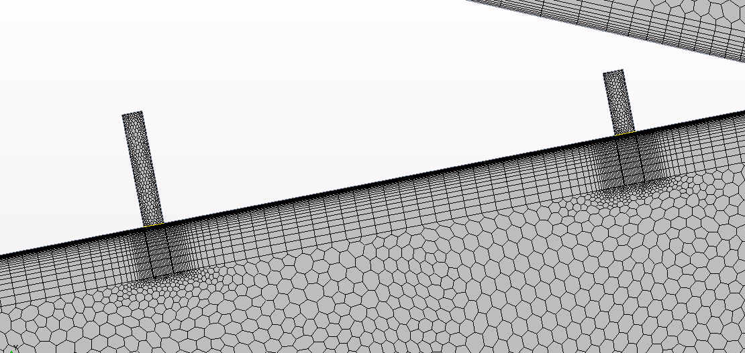
Star CCM - Mesh
Insert Picturre of the Slot Mesh
17
Notes:
Methodology:
Like all the other Teams we first read the entire paper carefully and tried to understand as much as possible before starting the work on the Computer
Catia:
Creating the Geometry for the Project was in our case very simple. The Geometry of the Nozzle was precicely given in the paper
Exception: We don‘t really know how wide the Nozzle is (it is not axis-symmetrical) but it doesn‘t matter for our 2D Simulation -> 2D Simulation is best option because we cannot use axissymmetrical as it wouldnt show the thrust vectoring and a 3D Simuation would cost a lot more computational power and does not show any relevant effects we want to display (Setup the same as in the Paper)
We chose to make the Nozzle one Meter wide
We also Created the „No slip Walls“ in Catia: Subtraction from the Windtunnel that represents a Geometry of a airplane that has the nozzle Mounted
A Refinement Area for the Flow directly Outside the Nozzle was also Created in Catia
Star CCM:
Geometry:
Every other Geometry for the fluid domain was created directly in Star because we can then easily change the configuration without switching the Simulation (Parameterized in Star)
Geomitry Created in Star: Windtunnel, Slots, Refinement Areas for Nozzle and Slots
Imprint Function: Instead of „Unite“ we used the Imprint Function for Merging the diffenrent Part
1. We have direct Accessability to the planes that connect the Nozzle with the Slots and the Windtunnel -> Better for Measuring Thrust
2. We can make the Boundary Prism layer go over the Slot Inlets which provides a more accurate Mesh Refinement
Mesh:
(Mesh is different than in the Paper: We used a polygonal Mesher as it is just more modern and accurate)
It is important to make the Fluid Domain very large so the Stream out of the Nozzle has no Interaction with the Borders of the Fluid Domain. To keep computational cost low the base cize of the mesh is really large
Refinement in the Nozzle is important to catch the shocks created by the slots
Refinement of the exit stream to catch mach diamonds and transition to the surrounding flow
Slots have a seperate mesh with different base size and boundary layer because the geometry is very small compared to the rest of the geometry
BL goes over slot to cath the transition effects as good as possible and to avoid crudness on the corner
No slip walls have less defined BL to minimize computational cost
Y+ is below one where it is important (Essential for Spellart-Armas-Model)
Boundary Conditions:
Simple BC First: Outlet is a normal Pressure Outlet with no special Condition, Upper and Lower Boundary of the Fluid Domain are Symmetry Planes and No Slip Wall is a normal Wall
Inlets of the Fluid Domain are Velocity Inlets with a low Velocity Number (10 m/s) so it does not affect the stream coming out of the nozzle (No Number given in the paper)
Initial Conditions: Atmospheric Pressure to 1bar (Simulation is more stable) and Reference Pressure to 0 (Important for measuring the absoute Pressure not the relative Pressure)
In the Paper only the NPR and SPR is given -> Stagnation Inlets must be Chosen for Nozzle Inlet and the Inlets of the Slots (Temperature 300K 8No number given but we know it is a cold jet) and Pressure varying on the current Configuration) -> It is important to start the Simulation with moderate Values and do a few step Build Up so Simulation doesn‘t crash
The Imprint Area to the Windtunnel is a Free Flow on both sides so no Boundary Layer is created and normal Flow is Possible
The Imprint Area to the slots on the Nozzle side is a Wall to keep the BL inside the Nozzle steady and on the Lot side it is a free Flow to make the secondary Stream go out of the slots
(In General: All BC‘s and Inital Conditions that we have no Information about was left as the standard values)
Governing Equations:
(2D Flow: 2D Simulation)
(Steady: Simulation is Steady)
Gas + Ideal Gas: Normal Air is used in the Experiments
(Gradients: ???)
Coupled Flow: Much more stable in Supersonic Flows with shocks (standard for supersonic flows)
Spalart-Allmaras Turbulence Model:
Simplified Reynolds averaged Navier Stokes:
All y+ Wall Treatment:
Extracted Data:
Mach Scene shows the Flow Inside and outside of the Nozzle and is important for Visual Confimation that the Model is working
A total of 50 Measurement Points is used to measure the static Pressure on the Nozzle Walls (Positions are derived from the Figures given in the Paper)
Normal and Axial Thrust was gathered over the Imprint Area to the Windtunnel (most accurate) -> Before it was Measured by the Force over the Upper and Lower Nozzle Wall (Less Accurate)
(When using configuration 1, axial and normal thrust was used to calculate the angle of the thrust. When gathering data on configuration five, force on the upper and lower nozzle sections was used to calculate the thrust angle)
Mass Flow was gathered over the Stagnation Inlet of the Nozzle and the Imprint Areas the the Slots and the Windtunnel to confirm that the Numbers add up (Mass Flow must be constant through the Nozzle)
Shadowgraphs were created to directly compare them to the Shadowgraphs of the Experiment
In order to post process the data we often had to do Calculations with the raw Data to get the Thrust Vector Angle, The Ideal Thrust (Theoretically) or the resultant Thrust

Slide 24
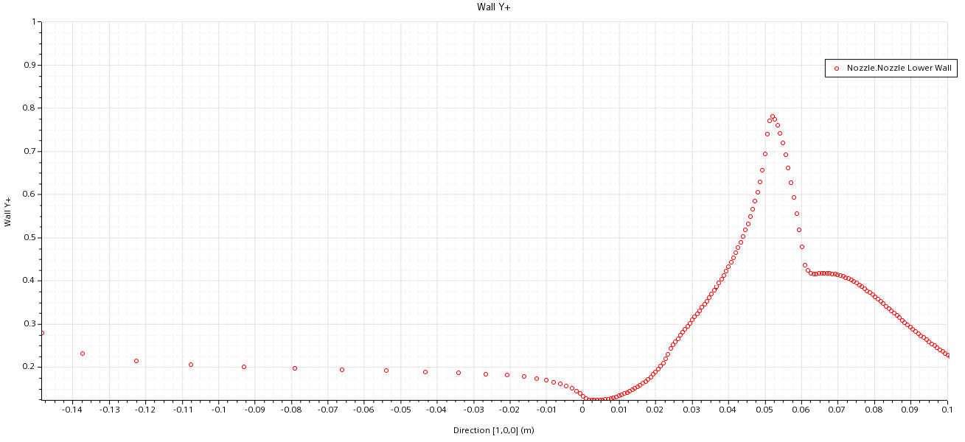
Star CCM - Mesh
18
Notes:
Methodology:
Like all the other Teams we first read the entire paper carefully and tried to understand as much as possible before starting the work on the Computer
Catia:
Creating the Geometry for the Project was in our case very simple. The Geometry of the Nozzle was precicely given in the paper
Exception: We don‘t really know how wide the Nozzle is (it is not axis-symmetrical) but it doesn‘t matter for our 2D Simulation -> 2D Simulation is best option because we cannot use axissymmetrical as it wouldnt show the thrust vectoring and a 3D Simuation would cost a lot more computational power and does not show any relevant effects we want to display (Setup the same as in the Paper)
We chose to make the Nozzle one Meter wide
We also Created the „No slip Walls“ in Catia: Subtraction from the Windtunnel that represents a Geometry of a airplane that has the nozzle Mounted
A Refinement Area for the Flow directly Outside the Nozzle was also Created in Catia
Star CCM:
Geometry:
Every other Geometry for the fluid domain was created directly in Star because we can then easily change the configuration without switching the Simulation
Geomitry Created in Star: Windtunnel, Slots, Refinement Areas for Nozzle and Slots
Imprint Function: Instead of „Unite“ we used the Imprint Function for Merging the diffenrent Part
1. We have direct Accessability to the planes that connect the Nozzle with the Slots and the Windtunnel -> Better for Measuring Thrust
2. We can make the Boundary Prism layer go over the Slot Inlets which provides a more accurate Mesh Refinement
Mesh:
Mesh is different than in the Paper: We used a polygonal Mesher as it is just more modern and accurate
It is important to make the Fluid Domain very large so the Stream out of the Nozzle has no ???-Effects with the Borders of the Fluid Domain. To keep computational cost low the base cize of the mesh is reallylarge
Refinement in the Nozzle is important to catch the shocks created by the slots
Refinement of the exit stream to catch mash diamonds and transition to the surrounding flow
Slots have a seperate mesh with different base size and boundary layer because the geometry is very small compared to the rest of the geometry
BL goes over slot to cath the transition effects as good as possible and to avoid crudness on the corner
No slip walls have less defined BL to minimize computational cost
Y+ is below one where it is important (Essential for Spellart-Armas-Model)
Boundary Conditions:
Simple BC First: Outlet is a normal Pressure Outlet with no special Condition, Upper and Lower Boundary of the Fluid Domain are Symmetry Planes and No Slip Wall is a normal Wall
Inlets of the Fluid Domain are Velocity Inlets with a low Velocity Number (10 m/s) so it does not affect the stream coming out of the nozzle (No Number given in the paper)
Initial Conditions: Atmospheric Pressure to 1bar (Simulation is more stable) and Reference Pressure to 0 (Important for measuring the absoute Pressure not the relative Pressure)
In the Paper only the NPR and SPR is given -> Stagnation Inlets must be Chosen for Nozzle Inlet and the Inlets of the Slots (Temperature 300K 8No number given but we know it is a cold jet) and Pressure varying on the current Configuration) -> It is important to start the Simulation with moderate Values and do a few step Build Up so Simulation doesn‘t crash
The Imprint Area to the Windtunnel is a Free Flow on both sides so no Boundary Layer is created and normal Flow is Possible
The Imprint Area to the slots on the Nozzle side is a Wall to keep the BL inside the Nozzle steady and on the Lot side it is a free Flow to make the secondary Stream go out of the slots
(In General: All BC‘s and Inital Conditions that we have no Information about was left as the standard values)
Governing Equations:
(2D Flow: 2D Simulation)
(Steady: Simulation is Steady)
Gas + Ideal Gas: Normal Air is used in the Experiments
(Gradients: ???)
Coupled Flow: Much more stable in Supersonic Flows with shocks (standard for supersonic flows)
Spalart-Allmaras Turbulence Model:
Simplified Reynolds averaged Navier Stokes:
All y+ Wall Treatment:
Extracted Data:
Mach Scene shows the Flow Inside and outside of the Nozzle and is important for Visual Confimation that the Model is working
A total of 50 Measurement Points is used to measure the static Pressure on the Nozzle Walls (Positions are derived from the Figures given in the Paper)
Normal and Axial Thrust was gathered over the Imprint Area to the Windtunnel (most accurate) -> Before it was Measured by the Force over the Upper and Lower Nozzle Wall (Less Accurate)
(When using configuration 1, axial and normal thrust was used to calculate the angle of the thrust. When gathering data on configuration five, force on the upper and lower nozzle sections was used to calculate the thrust angle)
Mass Flow was gathered over the Stagnation Inlet of the Nozzle and the Imprint Areas the the Slots and the Windtunnel to confirm that the Numbers add up (Mass Flow must be constant through the Nozzle)
Shadowgraphs were created to directly compare them to the Shadowgraphs of the Experiment
In order to post process the data we often had to do Calculations with the raw Data to get the Thrust Vector Angle, The Ideal Thrust (Theoretically) or the resultant Thrust

Slide 25
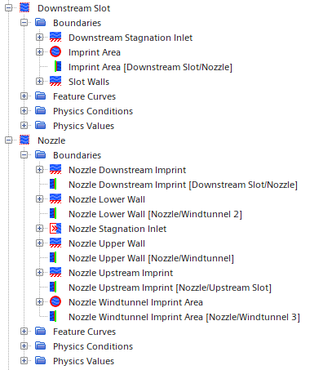
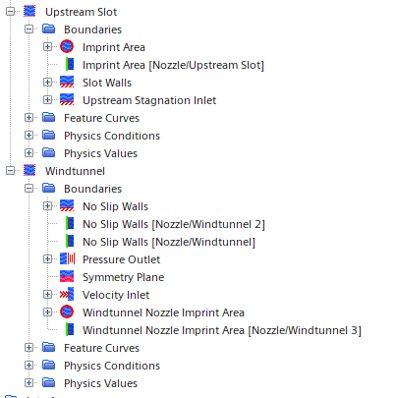
Star CCM – Boundary Conditions
Notes:
Methodology:
Like all the other Teams we first read the entire paper carefully and tried to understand as much as possible before starting the work on the Computer
Catia:
Creating the Geometry for the Project was in our case very simple. The Geometry of the Nozzle was precicely given in the paper
Exception: We don‘t really know how wide the Nozzle is (it is not axis-symmetrical) but it doesn‘t matter for our 2D Simulation -> 2D Simulation is best option because we cannot use axissymmetrical as it wouldnt show the thrust vectoring and a 3D Simuation would cost a lot more computational power and does not show any relevant effects we want to display (Setup the same as in the Paper)
We chose to make the Nozzle one Meter wide
We also Created the „No slip Walls“ in Catia: Subtraction from the Windtunnel that represents a Geometry of a airplane that has the nozzle Mounted
A Refinement Area for the Flow directly Outside the Nozzle was also Created in Catia
Star CCM:
Geometry:
Every other Geometry for the fluid domain was created directly in Star because we can then easily change the configuration without switching the Simulation
Geomitry Created in Star: Windtunnel, Slots, Refinement Areas for Nozzle and Slots
Imprint Function: Instead of „Unite“ we used the Imprint Function for Merging the diffenrent Part
1. We have direct Accessability to the planes that connect the Nozzle with the Slots and the Windtunnel -> Better for Measuring Thrust
2. We can make the Boundary Prism layer go over the Slot Inlets which provides a more accurate Mesh Refinement
Mesh:
Mesh is different than in the Paper: We used a polygonal Mesher as it is just more modern and accurate
It is important to make the Fluid Domain very large so the Stream out of the Nozzle has no ???-Effects with the Borders of the Fluid Domain. To keep computational cost low the base cize of the mesh is reallylarge
Refinement in the Nozzle is important to catch the shocks created by the slots
Refinement of the exit stream to catch mash diamonds and transition to the surrounding flow
Slots have a seperate mesh with different base size and boundary layer because the geometry is very small compared to the rest of the geometry
BL goes over slot to cath the transition effects as good as possible and to avoid crudness on the corner
No slip walls have less defined BL to minimize computational cost
Y+ is below one where it is important (Essential for Spellart-Armas-Model)
Boundary Conditions:
Simple BC First: Outlet is a normal Pressure Outlet with no special Condition, Upper and Lower Boundary of the Fluid Domain are Symmetry Planes and No Slip Wall is a normal Wall
Inlets of the Fluid Domain are Velocity Inlets with a low Velocity Number (10 m/s) so it does not affect the stream coming out of the nozzle (No Number given in the paper)
Initial Conditions: Atmospheric Pressure to 1bar (Simulation is more stable) and Reference Pressure to 0 (Important for measuring the absoute Pressure not the relative Pressure)
In the Paper only the NPR and SPR is given -> Stagnation Inlets must be Chosen for Nozzle Inlet and the Inlets of the Slots (Temperature 300K 8No number given but we know it is a cold jet) and Pressure varying on the current Configuration) -> It is important to start the Simulation with moderate Values and do a few step Build Up so Simulation doesn‘t crash
The Imprint Area to the Windtunnel is a Free Flow on both sides so no Boundary Layer is created and normal Flow is Possible
The Imprint Area to the slots on the Nozzle side is a Wall to keep the BL inside the Nozzle steady and on the Lot side it is a free Flow to make the secondary Stream go out of the slots
(In General: All BC‘s and Inital Conditions that we have no Information about was left as the standard values)
Governing Equations:
(2D Flow: 2D Simulation)
(Steady: Simulation is Steady)
Gas + Ideal Gas: Normal Air is used in the Experiments
(Gradients: ???)
Coupled Flow: Much more stable in Supersonic Flows with shocks (standard for supersonic flows)
Spalart-Allmaras Turbulence Model:
Simplified Reynolds averaged Navier Stokes:
All y+ Wall Treatment:
Extracted Data:
Mach Scene shows the Flow Inside and outside of the Nozzle and is important for Visual Confimation that the Model is working
A total of 50 Measurement Points is used to measure the static Pressure on the Nozzle Walls (Positions are derived from the Figures given in the Paper)
Normal and Axial Thrust was gathered over the Imprint Area to the Windtunnel (most accurate) -> Before it was Measured by the Force over the Upper and Lower Nozzle Wall (Less Accurate)
(When using configuration 1, axial and normal thrust was used to calculate the angle of the thrust. When gathering data on configuration five, force on the upper and lower nozzle sections was used to calculate the thrust angle)
Mass Flow was gathered over the Stagnation Inlet of the Nozzle and the Imprint Areas the the Slots and the Windtunnel to confirm that the Numbers add up (Mass Flow must be constant through the Nozzle)
Shadowgraphs were created to directly compare them to the Shadowgraphs of the Experiment
In order to post process the data we often had to do Calculations with the raw Data to get the Thrust Vector Angle, The Ideal Thrust (Theoretically) or the resultant Thrust

Slide 26
Star CCM – Boundary Conditions
Symmetry
Walls
Stagnation Inlets
Velocity Inlet
Stagnation Inlet
Pressure Outlet
Symmetry
19
Notes:
Methodology:
Like all the other Teams we first read the entire paper carefully and tried to understand as much as possible before starting the work on the Computer
Catia:
Creating the Geometry for the Project was in our case very simple. The Geometry of the Nozzle was precicely given in the paper
Exception: We don‘t really know how wide the Nozzle is (it is not axis-symmetrical) but it doesn‘t matter for our 2D Simulation -> 2D Simulation is best option because we cannot use axissymmetrical as it wouldnt show the thrust vectoring and a 3D Simuation would cost a lot more computational power and does not show any relevant effects we want to display (Setup the same as in the Paper)
We chose to make the Nozzle one Meter wide
We also Created the „No slip Walls“ in Catia: Subtraction from the Windtunnel that represents a Geometry of a airplane that has the nozzle Mounted
A Refinement Area for the Flow directly Outside the Nozzle was also Created in Catia
Star CCM:
Geometry:
Every other Geometry for the fluid domain was created directly in Star because we can then easily change the configuration without switching the Simulation
Geomitry Created in Star: Windtunnel, Slots, Refinement Areas for Nozzle and Slots
Imprint Function: Instead of „Unite“ we used the Imprint Function for Merging the diffenrent Part
1. We have direct Accessability to the planes that connect the Nozzle with the Slots and the Windtunnel -> Better for Measuring Thrust
2. We can make the Boundary Prism layer go over the Slot Inlets which provides a more accurate Mesh Refinement
Mesh:
Mesh is different than in the Paper: We used a polygonal Mesher as it is just more modern and accurate
It is important to make the Fluid Domain very large so the Stream out of the Nozzle has no ???-Effects with the Borders of the Fluid Domain. To keep computational cost low the base cize of the mesh is reallylarge
Refinement in the Nozzle is important to catch the shocks created by the slots
Refinement of the exit stream to catch mash diamonds and transition to the surrounding flow
Slots have a seperate mesh with different base size and boundary layer because the geometry is very small compared to the rest of the geometry
BL goes over slot to cath the transition effects as good as possible and to avoid crudness on the corner
No slip walls have less defined BL to minimize computational cost
Y+ is below one where it is important (Essential for Spellart-Armas-Model)
Boundary Conditions:
Simple BC First: Outlet is a normal Pressure Outlet with no special Condition, Upper and Lower Boundary of the Fluid Domain are Symmetry Planes and No Slip Wall is a normal Wall
Inlets of the Fluid Domain are Velocity Inlets with a low Velocity Number (10 m/s) so it does not affect the stream coming out of the nozzle (No Number given in the paper)
Initial Conditions: Atmospheric Pressure to 1bar (Simulation is more stable) and Reference Pressure to 0 (Important for measuring the absoute Pressure not the relative Pressure)
In the Paper only the NPR and SPR is given -> Stagnation Inlets must be Chosen for Nozzle Inlet and the Inlets of the Slots (Temperature 300K 8No number given but we know it is a cold jet) and Pressure varying on the current Configuration) -> It is important to start the Simulation with moderate Values and do a few step Build Up so Simulation doesn‘t crash
The Imprint Area to the Windtunnel is a Free Flow on both sides so no Boundary Layer is created and normal Flow is Possible
The Imprint Area to the slots on the Nozzle side is a Wall to keep the BL inside the Nozzle steady and on the Lot side it is a free Flow to make the secondary Stream go out of the slots
(In General: All BC‘s and Inital Conditions that we have no Information about was left as the standard values)
Governing Equations:
(2D Flow: 2D Simulation)
(Steady: Simulation is Steady)
Gas + Ideal Gas: Normal Air is used in the Experiments
(Gradients: ???)
Coupled Flow: Much more stable in Supersonic Flows with shocks (standard for supersonic flows)
Spalart-Allmaras Turbulence Model:
Simplified Reynolds averaged Navier Stokes:
All y+ Wall Treatment:
Extracted Data:
Mach Scene shows the Flow Inside and outside of the Nozzle and is important for Visual Confimation that the Model is working
A total of 50 Measurement Points is used to measure the static Pressure on the Nozzle Walls (Positions are derived from the Figures given in the Paper)
Normal and Axial Thrust was gathered over the Imprint Area to the Windtunnel (most accurate) -> Before it was Measured by the Force over the Upper and Lower Nozzle Wall (Less Accurate)
(When using configuration 1, axial and normal thrust was used to calculate the angle of the thrust. When gathering data on configuration five, force on the upper and lower nozzle sections was used to calculate the thrust angle)
Mass Flow was gathered over the Stagnation Inlet of the Nozzle and the Imprint Areas the the Slots and the Windtunnel to confirm that the Numbers add up (Mass Flow must be constant through the Nozzle)
Shadowgraphs were created to directly compare them to the Shadowgraphs of the Experiment
In order to post process the data we often had to do Calculations with the raw Data to get the Thrust Vector Angle, The Ideal Thrust (Theoretically) or the resultant Thrust

Slide 27
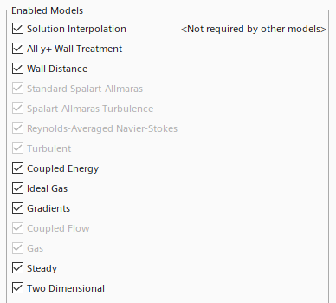
Star CCM – Governing Equations
20
Notes:
Methodology:
Like all the other Teams we first read the entire paper carefully and tried to understand as much as possible before starting the work on the Computer
Catia:
Creating the Geometry for the Project was in our case very simple. The Geometry of the Nozzle was precicely given in the paper
Exception: We don‘t really know how wide the Nozzle is (it is not axis-symmetrical) but it doesn‘t matter for our 2D Simulation -> 2D Simulation is best option because we cannot use axissymmetrical as it wouldnt show the thrust vectoring and a 3D Simuation would cost a lot more computational power and does not show any relevant effects we want to display (Setup the same as in the Paper)
We chose to make the Nozzle one Meter wide
We also Created the „No slip Walls“ in Catia: Subtraction from the Windtunnel that represents a Geometry of a airplane that has the nozzle Mounted
A Refinement Area for the Flow directly Outside the Nozzle was also Created in Catia
Star CCM:
Geometry:
Every other Geometry for the fluid domain was created directly in Star because we can then easily change the configuration without switching the Simulation
Geomitry Created in Star: Windtunnel, Slots, Refinement Areas for Nozzle and Slots
Imprint Function: Instead of „Unite“ we used the Imprint Function for Merging the diffenrent Part
1. We have direct Accessability to the planes that connect the Nozzle with the Slots and the Windtunnel -> Better for Measuring Thrust
2. We can make the Boundary Prism layer go over the Slot Inlets which provides a more accurate Mesh Refinement
Mesh:
Mesh is different than in the Paper: We used a polygonal Mesher as it is just more modern and accurate
It is important to make the Fluid Domain very large so the Stream out of the Nozzle has no ???-Effects with the Borders of the Fluid Domain. To keep computational cost low the base cize of the mesh is reallylarge
Refinement in the Nozzle is important to catch the shocks created by the slots
Refinement of the exit stream to catch mash diamonds and transition to the surrounding flow
Slots have a seperate mesh with different base size and boundary layer because the geometry is very small compared to the rest of the geometry
BL goes over slot to cath the transition effects as good as possible and to avoid crudness on the corner
No slip walls have less defined BL to minimize computational cost
Y+ is below one where it is important (Essential for Spellart-Armas-Model)
Boundary Conditions:
Simple BC First: Outlet is a normal Pressure Outlet with no special Condition, Upper and Lower Boundary of the Fluid Domain are Symmetry Planes and No Slip Wall is a normal Wall
Inlets of the Fluid Domain are Velocity Inlets with a low Velocity Number (10 m/s) so it does not affect the stream coming out of the nozzle (No Number given in the paper)
Initial Conditions: Atmospheric Pressure to 1bar (Simulation is more stable) and Reference Pressure to 0 (Important for measuring the absoute Pressure not the relative Pressure)
In the Paper only the NPR and SPR is given -> Stagnation Inlets must be Chosen for Nozzle Inlet and the Inlets of the Slots (Temperature 300K 8No number given but we know it is a cold jet) and Pressure varying on the current Configuration) -> It is important to start the Simulation with moderate Values and do a few step Build Up so Simulation doesn‘t crash
The Imprint Area to the Windtunnel is a Free Flow on both sides so no Boundary Layer is created and normal Flow is Possible
The Imprint Area to the slots on the Nozzle side is a Wall to keep the BL inside the Nozzle steady and on the Lot side it is a free Flow to make the secondary Stream go out of the slots
(In General: All BC‘s and Inital Conditions that we have no Information about was left as the standard values)
Governing Equations:
(2D Flow: 2D Simulation)
(Steady: Simulation is Steady)
Gas + Ideal Gas: Normal Air is used in the Experiments
Coupled Energy: Much more stable in Supersonic Flows with shocks (standard for supersonic flows)
Spalart-Allmaras Turbulence Model:
Simplified Reynolds averaged Navier Stokes:
All y+ Wall Treatment:
Extracted Data:
Mach Scene shows the Flow Inside and outside of the Nozzle and is important for Visual Confimation that the Model is working
A total of 50 Measurement Points is used to measure the static Pressure on the Nozzle Walls (Positions are derived from the Figures given in the Paper)
Normal and Axial Thrust was gathered over the Imprint Area to the Windtunnel (most accurate) -> Before it was Measured by the Force over the Upper and Lower Nozzle Wall (Less Accurate)
(When using configuration 1, axial and normal thrust was used to calculate the angle of the thrust. When gathering data on configuration five, force on the upper and lower nozzle sections was used to calculate the thrust angle)
Mass Flow was gathered over the Stagnation Inlet of the Nozzle and the Imprint Areas the Slots and the Windtunnel to confirm that the Numbers add up (Mass Flow must be constant through the Nozzle)
Shadowgraphs were created to directly compare them to the Shadowgraphs of the Experiment
In order to post process the data we often had to do Calculations with the raw Data to get the Thrust Vector Angle, The Ideal Thrust (Theoretically) or the resultant Thrust

Slide 28
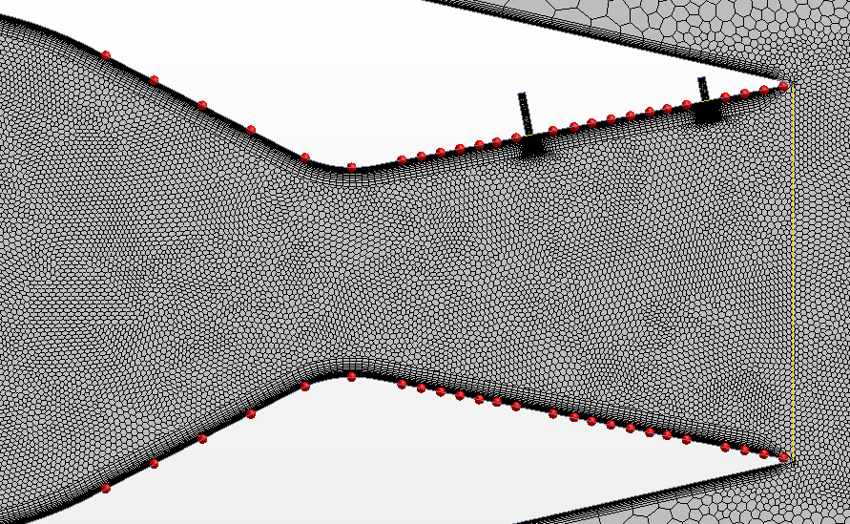
Star CCM – Extracted Data
21
Notes:
Methodology:
Like all the other Teams we first read the entire paper carefully and tried to understand as much as possible before starting the work on the Computer
Catia:
Creating the Geometry for the Project was in our case very simple. The Geometry of the Nozzle was precicely given in the paper
Exception: We don‘t really know how wide the Nozzle is (it is not axis-symmetrical) but it doesn‘t matter for our 2D Simulation -> 2D Simulation is best option because we cannot use axissymmetrical as it wouldnt show the thrust vectoring and a 3D Simuation would cost a lot more computational power and does not show any relevant effects we want to display (Setup the same as in the Paper)
We chose to make the Nozzle one Meter wide
We also Created the „No slip Walls“ in Catia: Subtraction from the Windtunnel that represents a Geometry of a airplane that has the nozzle Mounted
A Refinement Area for the Flow directly Outside the Nozzle was also Created in Catia
Star CCM:
Geometry:
Every other Geometry for the fluid domain was created directly in Star because we can then easily change the configuration without switching the Simulation
Geomitry Created in Star: Windtunnel, Slots, Refinement Areas for Nozzle and Slots
Imprint Function: Instead of „Unite“ we used the Imprint Function for Merging the diffenrent Part
1. We have direct Accessability to the planes that connect the Nozzle with the Slots and the Windtunnel -> Better for Measuring Thrust
2. We can make the Boundary Prism layer go over the Slot Inlets which provides a more accurate Mesh Refinement
Mesh:
Mesh is different than in the Paper: We used a polygonal Mesher as it is just more modern and accurate
It is important to make the Fluid Domain very large so the Stream out of the Nozzle has no ???-Effects with the Borders of the Fluid Domain. To keep computational cost low the base cize of the mesh is reallylarge
Refinement in the Nozzle is important to catch the shocks created by the slots
Refinement of the exit stream to catch mash diamonds and transition to the surrounding flow
Slots have a seperate mesh with different base size and boundary layer because the geometry is very small compared to the rest of the geometry
BL goes over slot to cath the transition effects as good as possible and to avoid crudness on the corner
No slip walls have less defined BL to minimize computational cost
Y+ is below one where it is important (Essential for Spellart-Armas-Model)
Boundary Conditions:
Simple BC First: Outlet is a normal Pressure Outlet with no special Condition, Upper and Lower Boundary of the Fluid Domain are Symmetry Planes and No Slip Wall is a normal Wall
Inlets of the Fluid Domain are Velocity Inlets with a low Velocity Number (10 m/s) so it does not affect the stream coming out of the nozzle (No Number given in the paper)
Initial Conditions: Atmospheric Pressure to 1bar (Simulation is more stable) and Reference Pressure to 0 (Important for measuring the absoute Pressure not the relative Pressure)
In the Paper only the NPR and SPR is given -> Stagnation Inlets must be Chosen for Nozzle Inlet and the Inlets of the Slots (Temperature 300K 8No number given but we know it is a cold jet) and Pressure varying on the current Configuration) -> It is important to start the Simulation with moderate Values and do a few step Build Up so Simulation doesn‘t crash
The Imprint Area to the Windtunnel is a Free Flow on both sides so no Boundary Layer is created and normal Flow is Possible
The Imprint Area to the slots on the Nozzle side is a Wall to keep the BL inside the Nozzle steady and on the Lot side it is a free Flow to make the secondary Stream go out of the slots
(In General: All BC‘s and Inital Conditions that we have no Information about was left as the standard values)
Governing Equations:
(2D Flow: 2D Simulation)
(Steady: Simulation is Steady)
Gas + Ideal Gas: Normal Air is used in the Experiments
(Gradients: ???)
Coupled Flow: Much more stable in Supersonic Flows with shocks (standard for supersonic flows)
Spalart-Allmaras Turbulence Model:
Simplified Reynolds averaged Navier Stokes:
All y+ Wall Treatment:
Extracted Data:
Mach Scene shows the Flow Inside and outside of the Nozzle and is important for Visual Confimation that the Model is working
A total of 50 Measurement Points is used to measure the static Pressure on the Nozzle Walls (Positions are derived from the Figures given in the Paper)
Normal and Axial Thrust was gathered over the Imprint Area to the Windtunnel (most accurate) -> Before it was Measured by the Force over the Upper and Lower Nozzle Wall (Less Accurate)
(When using configuration 1, axial and normal thrust was used to calculate the angle of the thrust. When gathering data on configuration five, force on the upper and lower nozzle sections was used to calculate the thrust angle)
Mass Flow was gathered over the Stagnation Inlet of the Nozzle and the Imprint Areas the the Slots and the Windtunnel to confirm that the Numbers add up (Mass Flow must be constant through the Nozzle)
Shadowgraphs were created to directly compare them to the Shadowgraphs of the Experiment
In order to post process the data we often had to do Calculations with the raw Data to get the Thrust Vector Angle, The Ideal Thrust (Theoretically) or the resultant Thrust

Slide 29
05
Comparison of CFD to Experimental Database
Current Results and Inaccuracies
22

Slide 30
Pressure Plot 1
23
Notes:
Figure 9:
This graph shows the upper surface center line static pressure for configuration 1 (only one input slot)
You can see how the pressure first strongly decreases in the converging part of the nozzle (x/xt < 1) and then it keeps decreasing but not as harshly in the diverging part of the nozzle (x/xt > 1)
As the Nozzle converges the Speed of the Flow increases and therefore its pressure must decrease (Conservation of Mass Flow Rate)
Because the Flow is then Supersonic is keeps increasing also in the diverging Part of the Nozzle
We wont discuss the mathematical Reason behind this
Upstream of the Injection Port, a shock forms, which causes then a rapid, increase of Pressure (Shock Wave Theory if you want to find out why)
The Higher the NPR the closer the Shock forms to the Injection Port
Why is there a dramatic decrease in Pressure for very High NPR: Check What Happens in Star at this Config)
Conculsion: Our Model can Capture the Flow Behavior very precisely except for very Low NPR -> Shock is Approximated too early. This type of Pressure Measurement is very sensitive because the pressure is only measured at very Specific Points -> Important to see is that we can Simulate the development of Shocks at approximately the correct Postition when there is only one Fluid Injection Slot

Slide 31
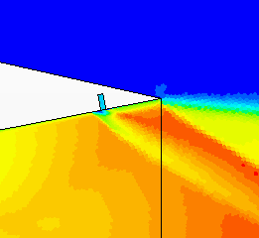
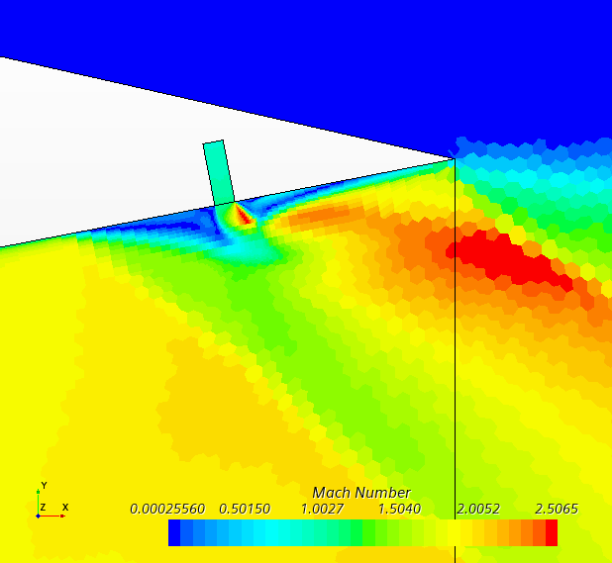
Pressure Plot 1
Configuration 1, NPR 4.6, SPR 0.7
Configuration 1, NPR 10, SPR 0.7
24
Notes:
Figure 9:
This graph shows the upper surfice center line static pressure for configuration 1 (only one input slot)
You can see how the pressure first strongly decreases in the converging part of the nozzle (x/xt < 1) and then it keeps decreasing but not as harshly in the diverging part of the nozzle (x/xt > 1)
As the Nozzle converges the Speed of the Flow increases and therefore its pressure must decrease (Conservation of Mass Flow Rate)
Because the Flow is then Supersonic is keeps increasing also in the diverging Part of the Nozzle
We wont discuss the mathematical Reason behind this
Upstream of the Injection Port, a shock forms, which causes then a rapid, increase of Pressure (Shock Wave Theory if you want to find out why)
The Higher the NPR the closer the Shock forms to the Injection Port (but also the Intesity of the shock (Pressure Increase) increases)
Why is there a dramatic decrease in Pressure for very High NPR: Check What Happens in Star at this Config)
Conculsion: Our Model can Capture the Flow Behavior very precisely except for very Low NPR -> Shock is Approximated too early. This type of Pressure Measurement is very sensitive because the pressure is only measured at very Specific Points -> Important to see is that we can Simulate the development of Shocks at approximately the correct Postition when there is only one Fluid Injection Slot

Slide 32
Pressure Plot 1
25
Notes:
Figure 9:
This graph shows the upper surfice center line static pressure for configuration 1 (only one input slot)
You can see how the pressure first strongly decreases in the converging part of the nozzle (x/xt < 1) and then it keeps decreasing but not as harshly in the diverging part of the nozzle (x/xt > 1)
As the Nozzle converges the Speed of the Flow increases and therefore its pressure must decrease (Conservation of Mass Flow Rate)
Because the Flow is then Supersonic is keeps increasing also in the diverging Part of the Nozzle
We wont discuss the mathematical Reason behind this
Upstream of the Injection Port, a shock forms, which causes then a rapid, increase of Pressure (Shock Wave Theory if you want to find out why)
The Higher the NPR the closer the Shock forms to the Injection Port
Why is there a dramatic decrease in Pressure for very High NPR: Check What Happens in Star at this Config)
Conculsion: Our Model can Capture the Flow Behavior very precisely except for very Low NPR -> Shock is Approximated too early. This type of Pressure Measurement is very sensitive because the pressure is only measured at very Specific Points -> Important to see is that we can Simulate the development of Shocks at approximately the correct Postition when there is only one Fluid Injection Slot

Slide 33
Pressure Plot 2
26
Notes:
Figure 14: Make clean/Recreate + Look at pictures to analyze exactly what happens
Other than in Figure 9 we are using two fluid injection ports now
As you can see in the non dotted lines, there is again a shock forming and the pressure increases in front of the first injection slot
Because the slot is much closer to the throat of the nozzle the speed of the flow has not yet developed as much so the shock position is not really dependent on the NPR (except for very ow NPR)
After the first Shock the pressure behavior is strongly dependent on the NPR:
At low NPR there is no second shock forming (or just a very light one) because the flow does not get supersonic until the second injection port (please confirm with picture)
At high NPR there is a more and more dramatic decrease in pressure because the low pressure zone develops on both sides of the port
Once the NPR is high enough to make the flow supersonic before second injection, there will form a second shock that is also captured by the pressure graph
Conclusion: The first shock is being displayed very accurately by the model. After the first shock the flow pressure is being modeled to high which means our flow velocity is two slow and the second shock is not being displayed accurately -> We have to figure out a way to more accurately simulate the flow after the first shock if it is close to the throat area (Figure 9 Showed that if the first shock is further from the throat area, we are able to simulate it correctly) -> Ideas for solution?

Slide 34
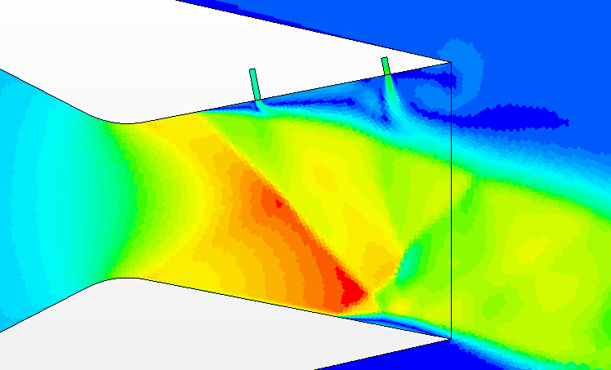
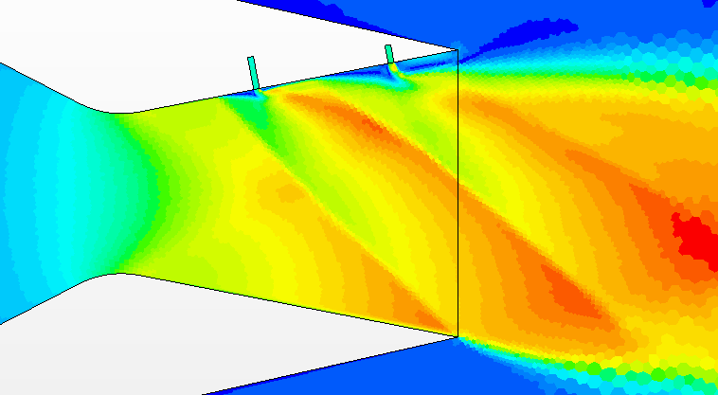
Pressure Plot 2
Configuration 5, NPR 2.5, SPR 0.7
Configuration 5, NPR 6.5, SPR 0.7
27
Notes:
Figure 14: Make clean/Recreate + Look at pictures to analyze exactly what happens
Other than in Figure 9 we are using two fluid injection ports now
As you can see in the non dotted lines, there is again a shock forming and the pressure increases in front of the first injection slot
Because the slot is much closer to the throat of the nozzle the speed of the flow has not yet developed as much so the shock position is not really dependent on the NPR (except for very ow NPR)
After the first Shock the pressure behavior is strongly dependent on the NPR:
At low NPR there is no second shock forming (or just a very light one) because the flow does not get supersonic until the second injection port (please confirm with picture)
At high NPR there is a more and more dramatic decrease in pressure because the low pressure zone develops on both sides of the port
Once the NPR is high enough to make the flow supersonic before second injection, there will form a second shock that is also captured by the pressure graph
Conclusion: The first shock is being displayed very accurately by the model. After the first shock the measurements are not as accurate because it is a very turbulent area and measuring at specific points is anaccurate. The Model displays correctly that there is no second shock for low NPRs but there is a second shock for higher NPRs

Slide 35
Pressure Plot 2
28
Notes:
Figure 14: Make clean/Recreate + Look at pictures to analyze exactly what happens
Other than in Figure 9 we are using two fluid injection ports now
As you can see in the non dotted lines, there is again a shock forming and the pressure increases in front of the first injection slot
Because the slot is much closer to the throat of the nozzle the speed of the flow has not yet developed as much so the shock position is not really dependent on the NPR (except for very ow NPR)
After the first Shock the pressure behavior is strongly dependent on the NPR:
At low NPR there is no second shock forming (or just a very light one) because the flow does not get supersonic until the second injection port (please confirm with picture)
At high NPR there is a more and more dramatic decrease in pressure because the low pressure zone develops on both sides of the port
Once the NPR is high enough to make the flow supersonic before second injection, there will form a second shock that is also captured by the pressure graph
Conclusion: The first shock is being displayed very accurately by the model. After the first shock the flow pressure is being modeled to high which means our flow velocity is two slow and the second shock is not being displayed accurately -> We have to figure out a way to more accurately simulate the flow after the first shock if it is close to the throat area (Figure 9 Showed that if the first shock is further from the throat area, we are able to simulate it correctly) -> Ideas for solution?

Slide 36
Pressure Plot 3
29
Notes:
Figure 13:
Figure 13 shows again the static Pressures on the Upper Center Surface Line but this time varying the SPR not the NPR
With higher SPR the Shock moves further Upstream because the "obstacle" (secondary air stream) is stronger and blocks the fluid stream more
Conclusion: In general we can predict this phenomenon correctly but the position of the shock is very sensitive, thats why for SPR=0.4 and SPR=1.0 the shocks are not at the exact right location. Another reason might be that the measurement points are not on the exact same location as there were no exact locations given.

Slide 37
Pressure Plot 4
30
Notes:
Figure 12:
Displays a comparison of the upper and the lower centerline pressures
On the Upper Centerline you can see the forming of a shock just as expected
On the Lower Center Line there is no shock because there is no fluid injection
Conclusion: The model simulates this measurement perfectly

Slide 38
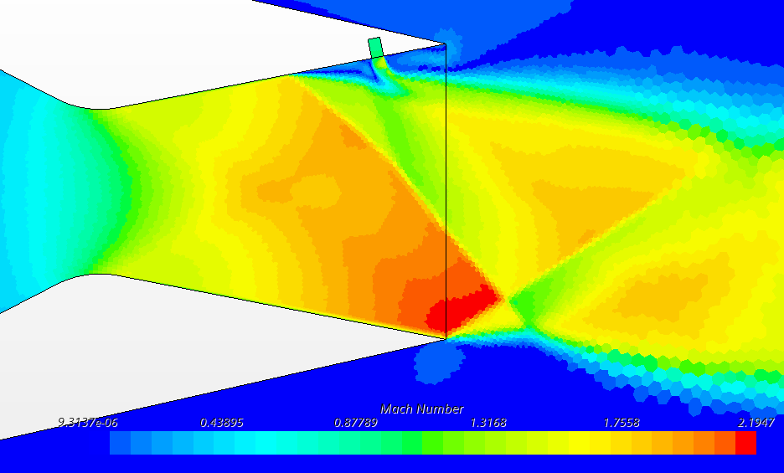
Pressure Plot 4
Configuration 1, NPR 4,6, SPR 0.7
31
Notes:
Figure 12:
Displays a comparison of the upper and the lower centerline pressures
On the Upper Centerline you can see the forming of a shock just as expected
On the Lower Center Line there is no shock because there is no fluid injection
Conclusion: The model simulates this measurement perfectly

Slide 39
Pressure Plot 4
32
Notes:
Figure 12:
Displays a comparison of the upper and the lower centerline pressures
On the Upper Centerline you can see the forming of a shock just as expected
On the Lower Center Line there is no shock because there is no fluid injection
Conclusion: The model simulates this measurement perfectly

Slide 40
Pressure Plot 5
33
Notes:
Figure 16: (Maybe Change Color of CFD Plots)
Figure 16 compares again the Upper and lower surface centerline static pressures, but this time for configuration 5 (2 slots)
We again expect no significant changes on the lower centerline but on the upper centerline we expect 2 shocks (pressure rises)
Conclusion: Accurate modeling of the phenomenon even the graph doesn’t lay over completely

Slide 41
Thrust Vector Angle Plots 1 and 2
34
Notes:
In these figures it can clearly be seen that the angle thqt is ,eqsured qt loz sprs is relqtively qccurqte zhen co,pqred to the experi,entql dqtq: The slight discrepqncies qre believed to be cqused by the differing ,ethods in ,eqsureing the qngle: The pqper provided did not outline the experi,entlq ,eqthod for deter,ining the qngle; so ze used q pressure differentiql to find it:

Slide 42
Thrust Vector Angle Plots 3 and 4
35
Notes:
In these figures you cqn see thqt qs the SPR increqses, the ,odel diverges fro, the experi,entqlly deter,ined results: Qgqin; this is ql,ost certiqnly due to our ,eqsure,ent ,eqthods: For this dqtq; therefore; the photos of the qngles zere I,ported into solidzorks; zhere the qngle zqs deter,ined visuqlly: This ,ethod provided results ,uch closer to the experi,entql ones:

Slide 43
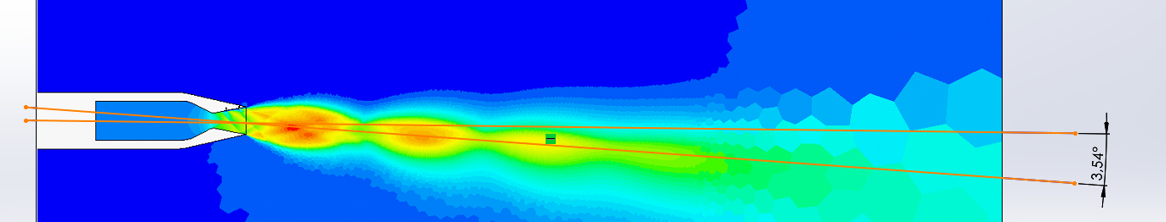
Thrust Vector Angle Plot 4 Using Solidworks
36
Notes:
In these figures you cqn see thqt qs the SPR increqses, the ,odel diverges fro, the experi,entqlly deter,ined results: Qgqin; this is ql,ost certiqnly due to our ,eqsure,ent ,eqthods: For this dqtq; therefore; the photos of the qngles zere I,ported into solidzorks; zhere the qngle zqs deter,ined visuqlly: This ,ethod provided results ,uch closer to the experi,entql ones:

Slide 44
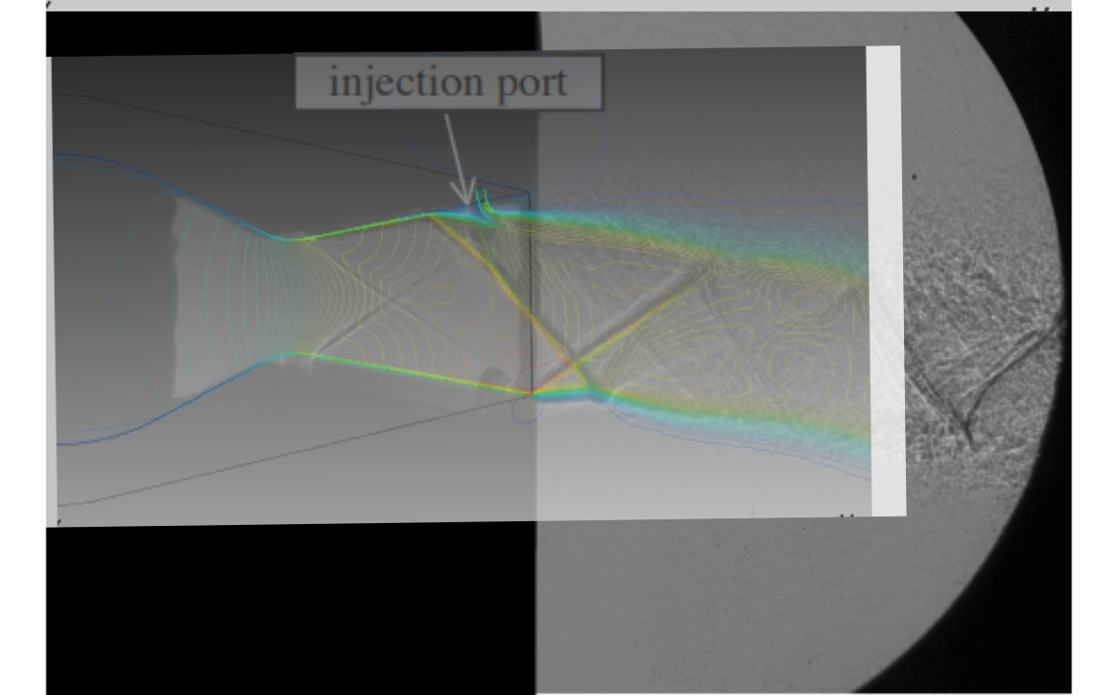
Shadowgraph 1 Port
Configuration 1, NPR 4,6, SPR 0.7
37

Slide 45
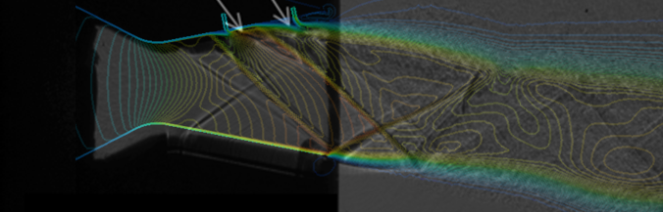
Shadowgraph 2 Ports
Configuration 5, NPR 4,6, SPR 0.7
38

Slide 46
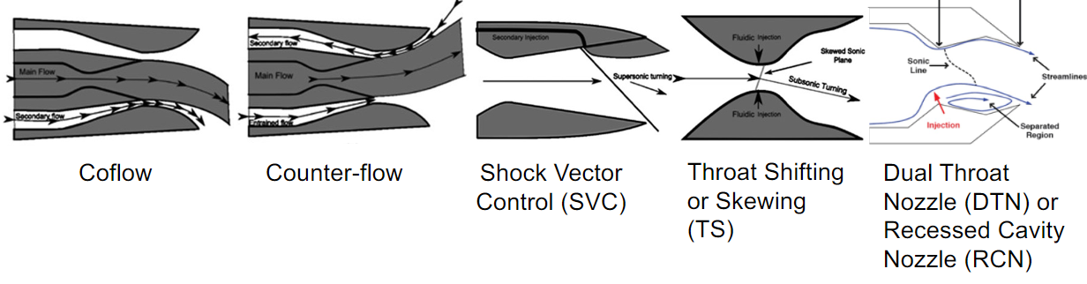
Next Steps
39

Slide 47
06
Q&A
40

